Slide 1
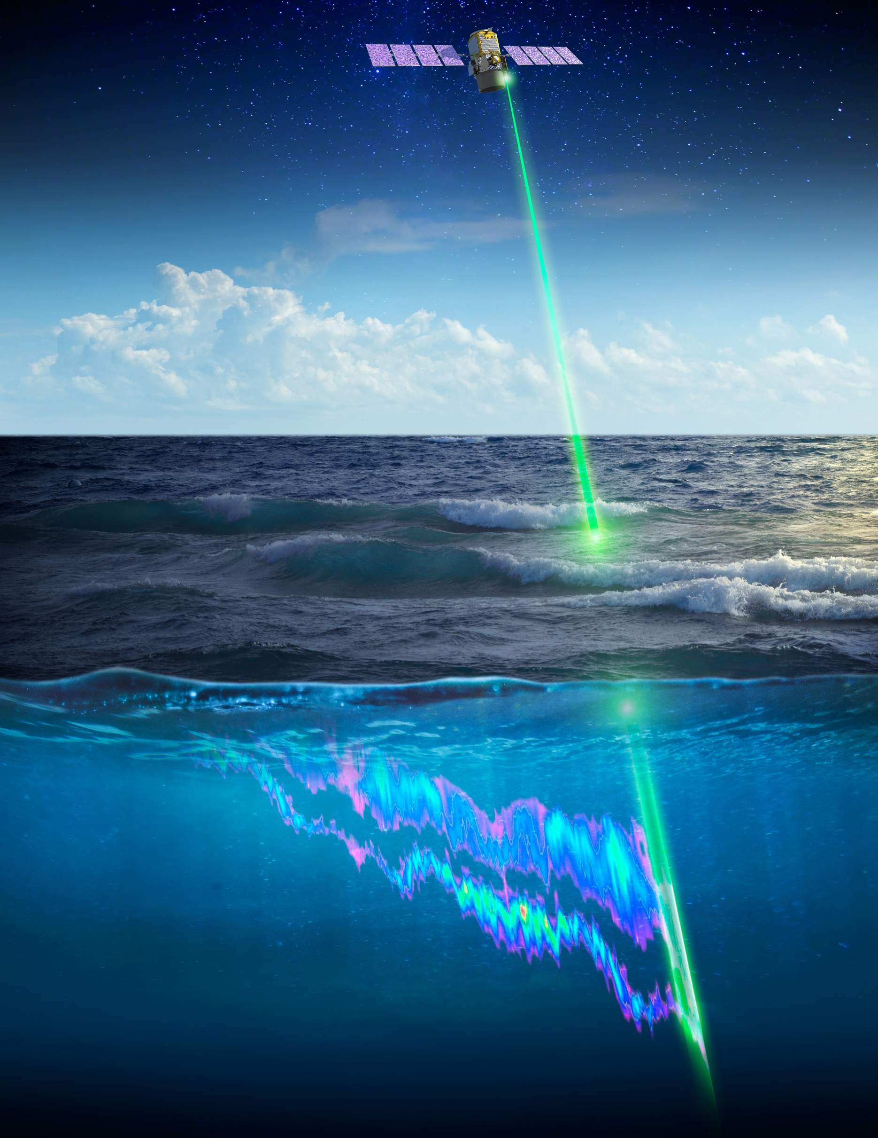
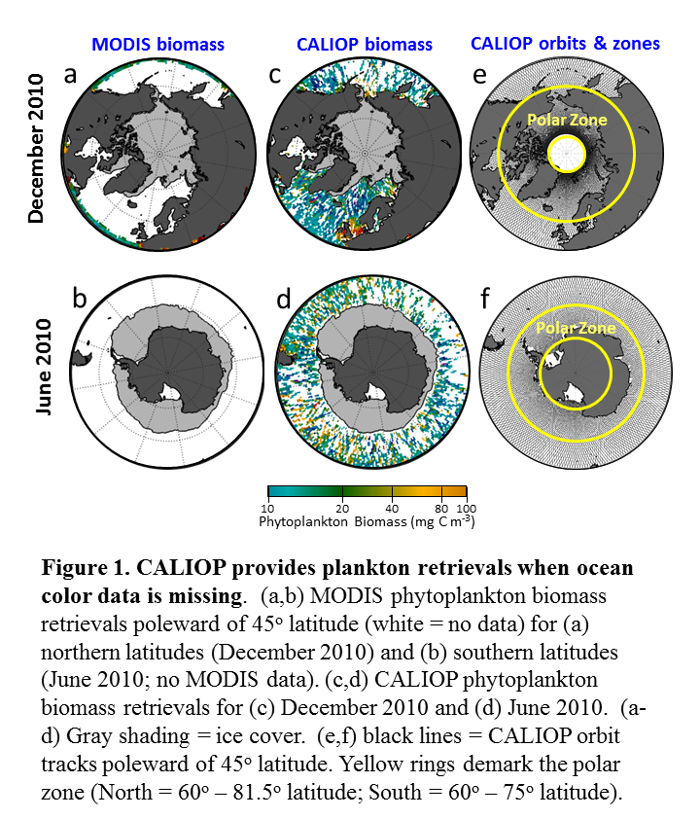
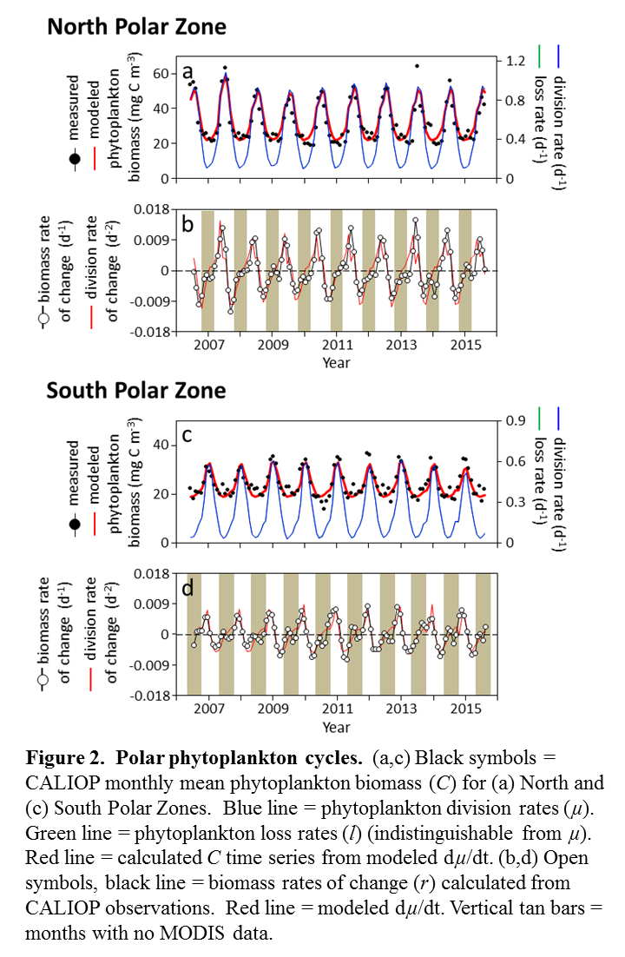
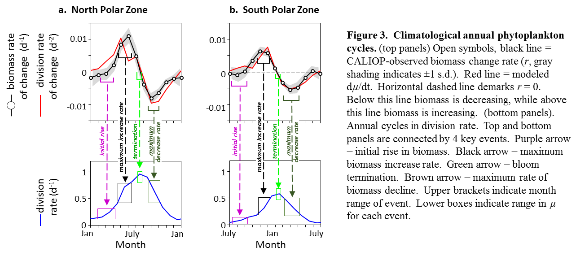
Satellite lidar
observations of polar
phytoplankton biomass cycles
Michael J. Behrenfeld, Yongxiang Hu, Robert T. O’Malley, Emmanuel S. Boss, Chris A. Hostetler, David A.
Siegel, Jorge Sarmiento, Jennifer Schulien, Johnathan W. Hair, Xiaomei Lu, Sharon Rodier, Amy Jo Scarino
SUMMARY: Polar plankton communities are among the most productive, seasonally-dynamic, and rapidly-changing ecosystems in the global ocean. Unfortunately, persistent cloud cover, periods of constant night, and low solar elevations severely limit passive ocean color data and leave vast areas unobserved for many consecutive months each year. To overcome these issues, uninterrupted polar plankton annual cycles were evaluated using observations from a space-borne lidar (CALIOP). The lidar data show (1) the annual ‘bloom-bust’ cycle reflects slight imbalances in predator-prey equilibria driven by (and predictable from) accelerations and decelerations in phytoplankton division rates and (2) biomass accumulation rates are not proportional to.division rate.
FROM
Behrenfeld, M.J., et al. 2017. Annual boom-bust cycles of polar phytoplankton biomass revealed by space-based lidar. Nature Geoscience doi: 10.1038/NGEO2861.
RELATED PUBLICATIONS
Behrenfeld, M.J., Boss, E.S. 2017. Student’s tutorial on bloom hypotheses in the context of phytoplankton annual cycles. Global Change Biol. 24: 55-77.
Hostetler, C.A., et al. 2018. Spaceborne lidar in the sudy of marine systems. Ann. Rev. Mar. Sci..
Schulien, J.A., et al. 2017 Vertically resolved phytoplankton carbon and net primary production from a High Spectral Resolution Lidar. Opt. Express 25:13577-87.
Behrenfeld, M.J. 2014. Climate-mediated dance of the plankton. Nature Climate Change. 4, 880-887.
Behrenfeld, M.J., et al. 2013. Annual cycles of ecological disturbance and recovery underlying the subarctic Atlantic spring plankton bloom. Global Biogeochem. Cycl. 27:526-540.
Behrenfeld, M.J., Boss, E.S. 2013. Resurrecting the ecological underpinnings of ocean plankton blooms. Ann. Rev. Mar. Sci. 6:167–94.
Behrenfeld, M.J., et al. 2013. Space-based lidar observations of global ocean plankton populations. Geophys. Res. Lett. 40: 4355-4360, doi:10.1002/grl.50816.
Boss, E., Behrenfeld, M.J. 2010. In-situ evaluation of the initiation of the North Atlantic phytoplankton bloom. Geophysical Research Letters. 37: L18603, doi:10.1029/2010GL044174.
Behrenfeld, M.J. 2010. Abandoning Sverdrup’s Critical Depth Hypothesis on phytoplankton blooms. Ecology 91(4): 977–989.
Notes:
<number>

