Slide 1
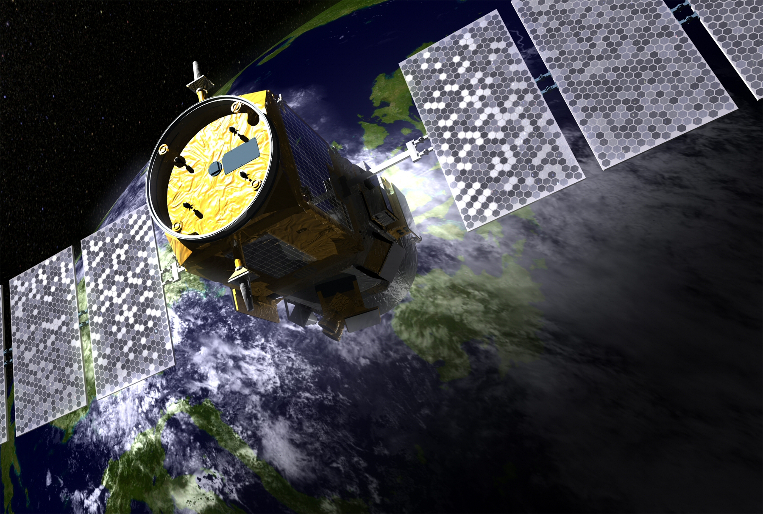
Dawn of Satellite
Lidar in Oceanography
Notes:
<number>
your talk should be 35 min long, allowing 10 minutes for questions
remember to read your own papers before the meeting including methods

Slide 2
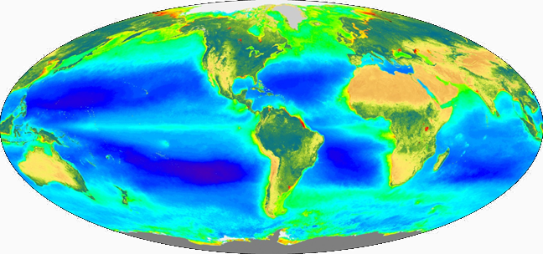
Passive Ocean Color Measurements
atmosphere dominates measured signal and correction is challenging
ocean component of signal dominated by upper ½ optical depth
no direct information on vertical distribution of ocean constituents
an optically integrated property without a direct signal for separating absorption and scattering fractions
global sampling is compromised by aerosols, clouds, solar angle (in the extreme, polar night)
no information on plankton properties at night
Notes:
call out errors associated with no veritical information
<number>

Slide 3
Active Lidar Ocean Measurements
Lidar (Light Detection And Ranging)
signal from a known source (laser)
constant viewing geometry
minimal atmosphere correction issues
penetrates deep into photic layer
resolves vertical structure
can directly separate absorption and particulate scattering
retrievals through aerosols/thin clouds & between clouds
day and night sampling

Slide 4
Roadmap
How does it work?
Notes from the field
Going to space
Little bit o’ science
Solving a problem
Looking ahead

Slide 5
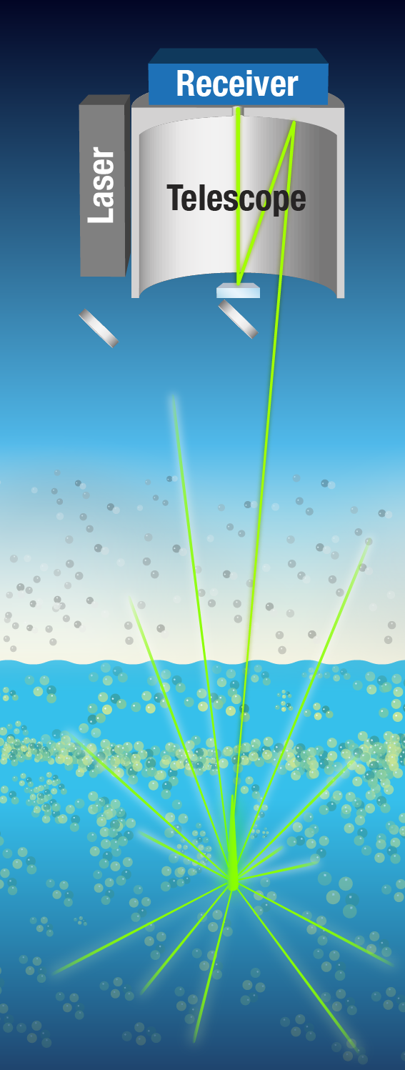
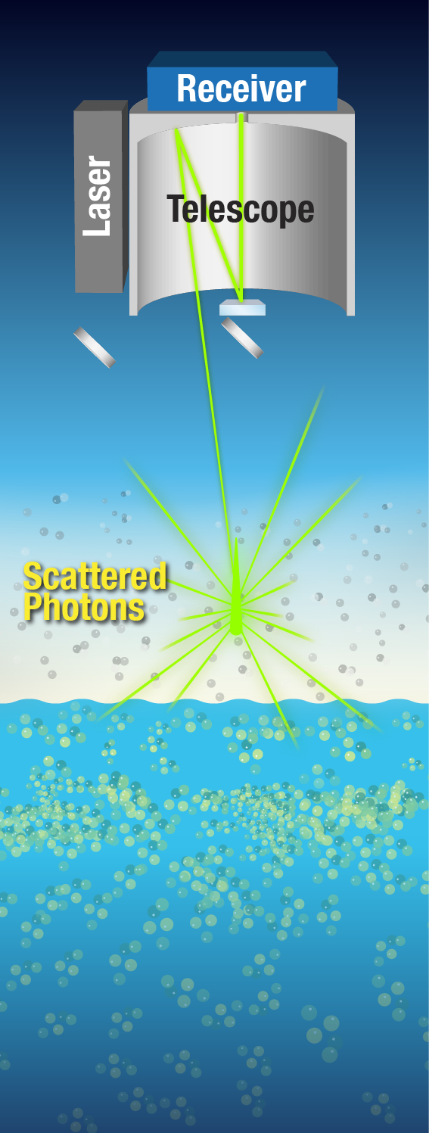
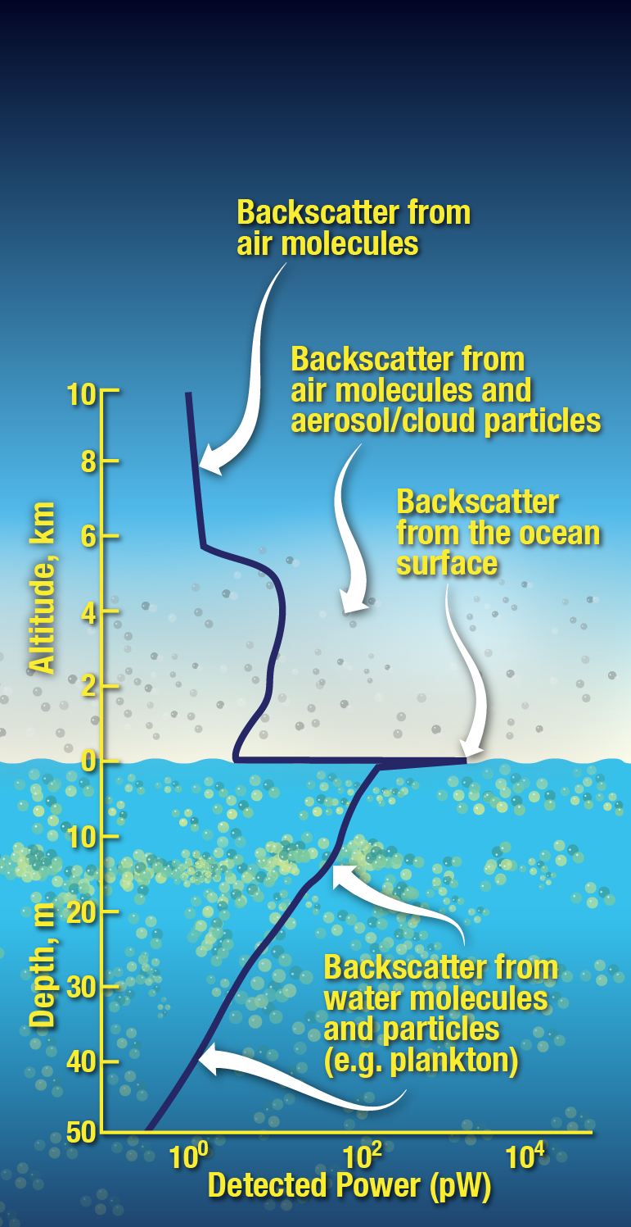
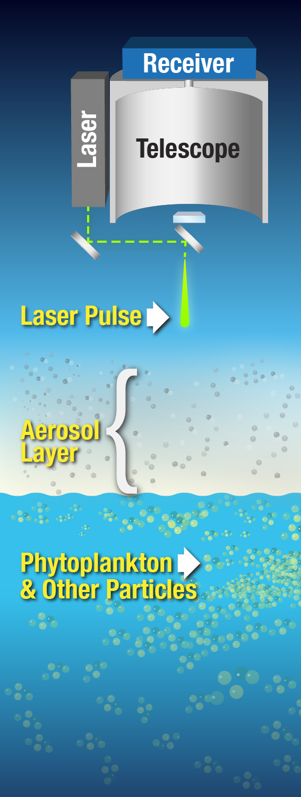
Lidar 101: How does it work?

Slide 6
Increasing Information Content
Other
Channels
Nd:Yg laser 1064 nm fundamental wavelength
frequency double to 532 nm & triple to 355 nm
polarized emission
co-polarized & cross-polarized detection
fluorescence detection bands
high-resolution spectral filtering
vertical sampling (detector sampling rate, laser temporal pulse width)
Laser
Telescope
PMT
PMT
Cross-Polarized Scattering Channel
Co-Polarized Scattering Channel
Aerosol Layer
Ocean

Slide 7
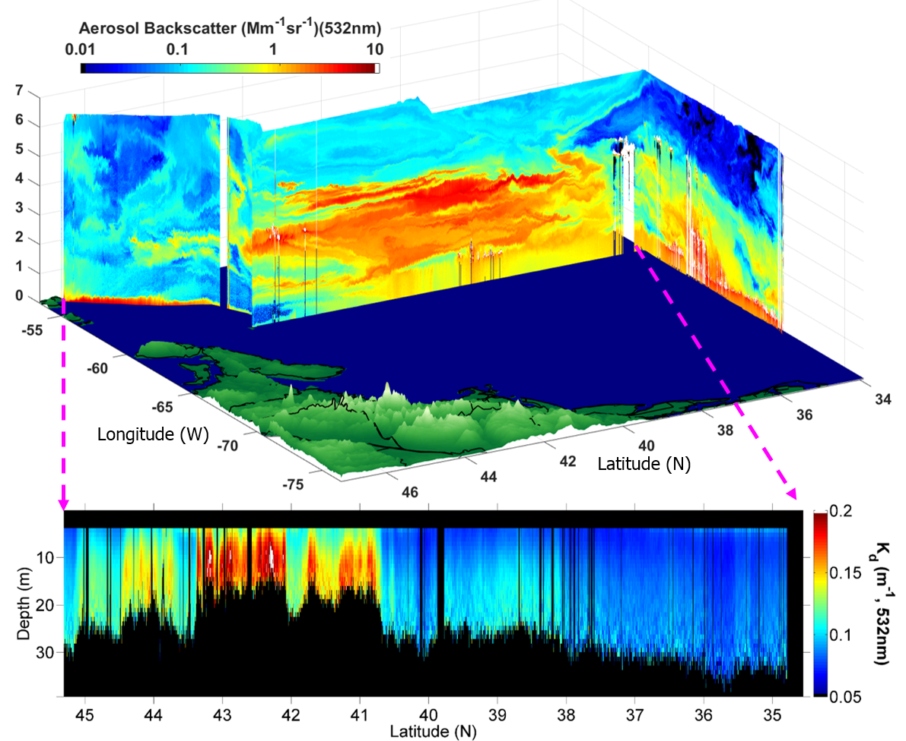
The Lidar ‘Curtain’
Smoke
Nova Scotia
Chesapeake Bay
Diffuse Attenuation Coefficient
* note, these data are from an advanced airborne lidar system (discussed later)

Slide 8
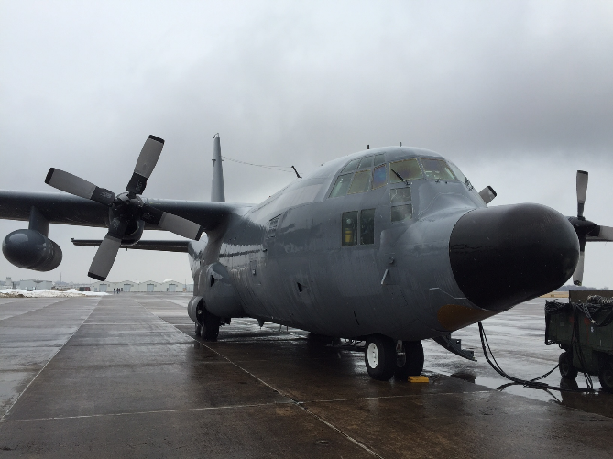
Notes from the field: Airborne lidar

Slide 9
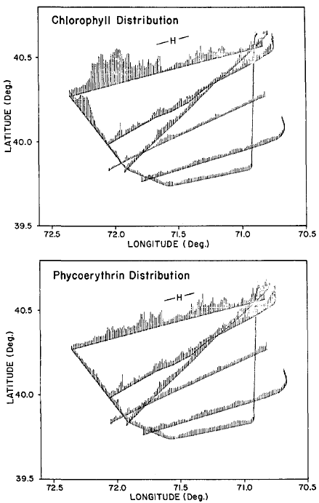
Early Airborne Measurements
Kim et al. 1973: Chlorophyll fluorescence
Bristow et al. 1981, Hoge et al. 1981, 1986: Raman to quantify chlorophyll & phycoerythrin
Billard et al. 1986, Hoge et al. 1988, Smart & Kwon 1996, Bunkin & Surovegin 1992: Early profiling of (relative) backscattering attenuation
Hoge et al. 1993, 1995: 355 nm for CDOM
Yoder et al. 1993: Chlorophyll spatial variability during JGOFS North Atlantic Bloom Experiment
Martin et al. 1994: Chlorophyll fluorescence to map iron stress response during IronExI
From: Hoge et al. 1986
Notes:
Kim - based at Wallops / instrument flown in helicopter over Ches. Bay and Lake Ontario at 8 m above surface / laser 590 nm / detect @ 685 / results compared to in situ chl
<number>

Slide 10
Airborne LiDAR profiling – Jim Churnside
Churnside et al. 1991, 2001, 2003: Detect/quantify fish schools
Churnside & Ostrovsky 2005, Churnside & Donaghay 2009: Detect plankton layers
Churnside et al. 2014, Churnside & Marchbanks 2015: bio-optical modeling to
separate attenuation and backscatter
Churnside 2015: attenuation, backscatter, & chlorophyll
Churnside 2016: vertical distribution of net primary productivity
Notes:
<number>

Slide 11
…can we do it from space?

Slide 12
Going to Space
Notes:
<number>

Slide 13
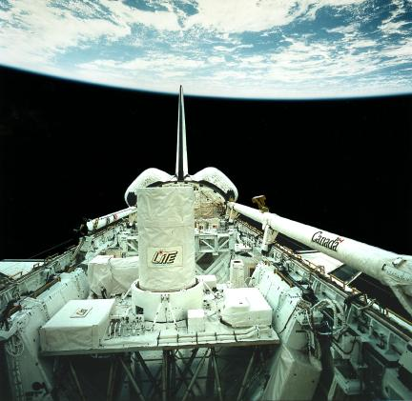
Lidar In-space Technology Experiment (LITE)
High Gain
Low Gain
HG
0.6
532 nm
0.4
Discovery Space Shuttle in September 1994
3-wavelength Nd-Yg lidar
1064 = 486 mJ; 532 = 460 mJ; 355 = 196 mJ
Multi-angle (+/-30⁰) maneuvers over Lake Superior and Gulf of California
height
0.2
0
ocean surface
15⁰
15⁰
0.6
1064 nm
40
0.4
30
height
Off-Nadir Angle
0.2
20
10
0
ocean surface
0
Time
time
Notes:
<number>
Lite: first real atmospheric lidar measurements from space
High power: 1064 = 486 mJ; 532 = 460 mJ; 355 = 196 mJ
10 Hz

Slide 14
two important things then happened…

Slide 15
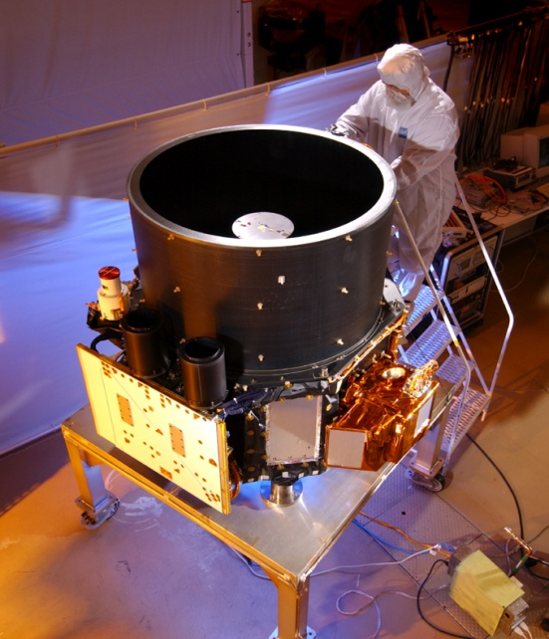
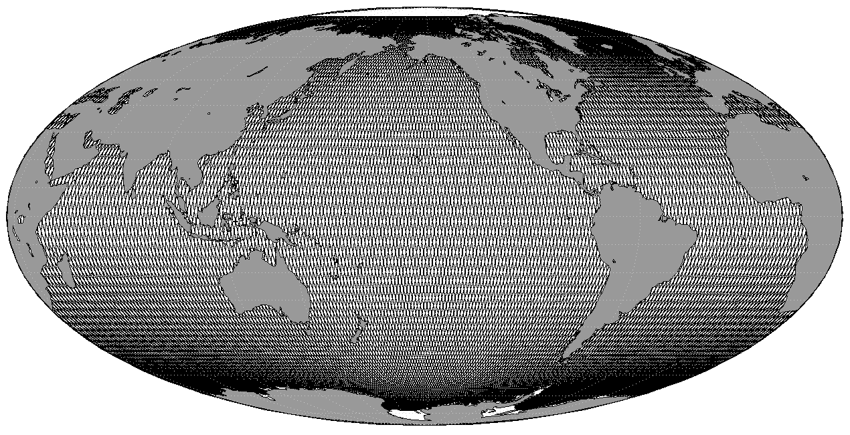
#1. Cloud-Aerosol Lidar with Orthogonal Polarization
(CALIOP)
NASA-CNES partnership
launched April 28, 2006, still active
definitively NOT designed for ocean applications
2-wavelength 110 mJ Nd:Yg laser (532, 1064 nm)
3-channel (532‖, 532 ┴ , 1064 nm)
1 meter telescope
100 m footprint
30 m air / 23 m water vertical resolution
polar orbiting, 16 day repeat cycle
measurements both day and night
lasers
Notes:
<number>

Slide 16
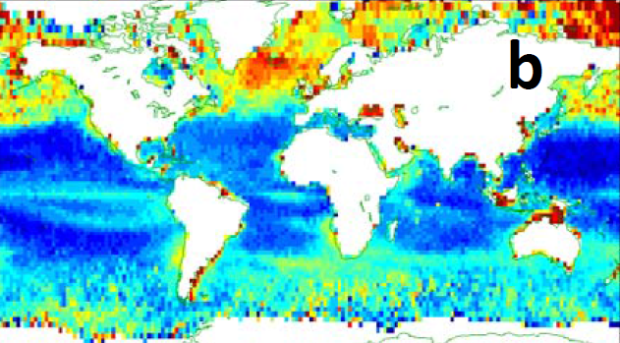
#2. Yongxiang ‘Yong’ Hu
OCRT 2007
*
* β_{W+} = column integrated cross polarized ocean lidar backscatter
Churnside et al. 2013. Rem. Sens. 5:3457-75 (evaluate detection, MODIS comparison)
Behrenfeld et al. 2013 Geophys. Res. Lett. 40, 4355-60 (field val, geophysical prod’s)
Notes:
used deplolarization ratio (vertically integrated to polarization ratio) estimated what the contribution was fromsurface reflection, then used cloud sat or wind data to remove surface problem
surface flash and calibration of data (goes through the atmosphere)
-depolariation ratio is very well calibrated
- LOOK AT SUPPLEMENT OF MY 2013 PAPER TO UNDERSTAND THIS
<number>

Slide 17
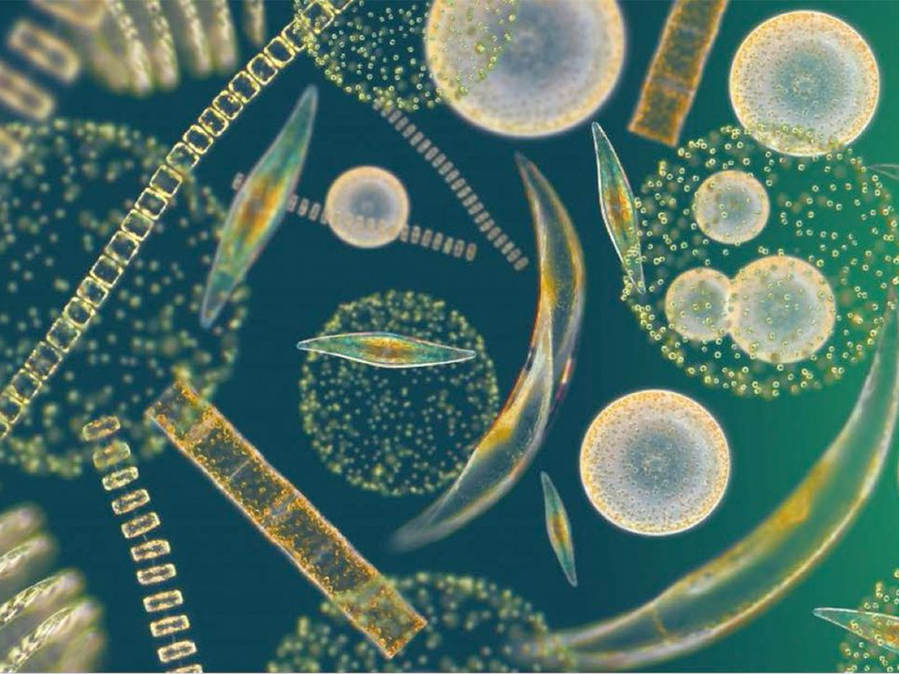
Little bit o’ science

Slide 18
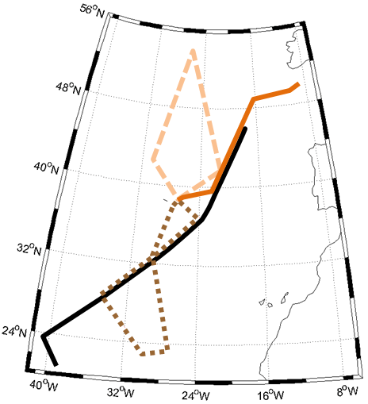
Field-testing Retrievals
Ship in situ
CALIOP
MODIS GSM
16:00
14:00
13:00/
16:00
13:00
18:00
Oct. 17
13:00/18:30
Oct 13
11:00/18:00
13:00/18:30
Oct. 18
Latitude (ºN)
b_{bp} x 10³ (m⁻¹)
14:00/18:00
Airborne lidar
CALIOP
MODIS GSM
17:00
16:00
Ship Track
Flight Tracks
Oct. 13
Oct. 17
Oct. 18
11:00
14:00
17:00
13:00
15:30
18:00
13:00
15:30
17:00
Local Time
Behrenfeld et al. 2013 Geophys. Res. Lett. 40, 4355-4360

Slide 19
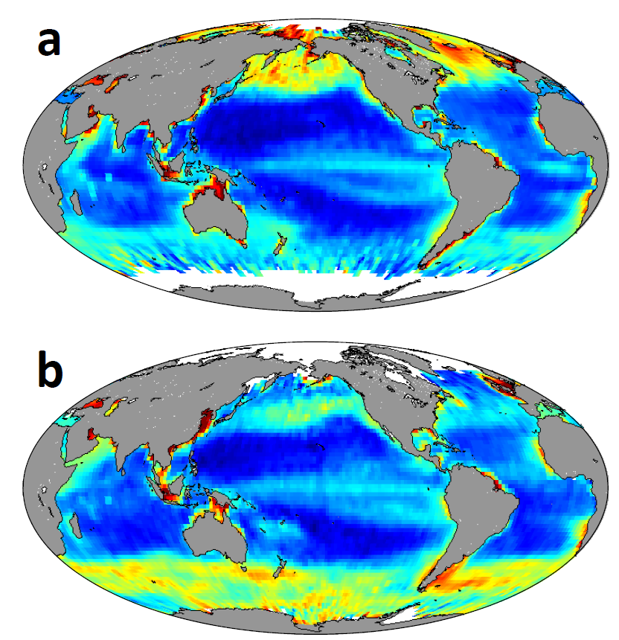
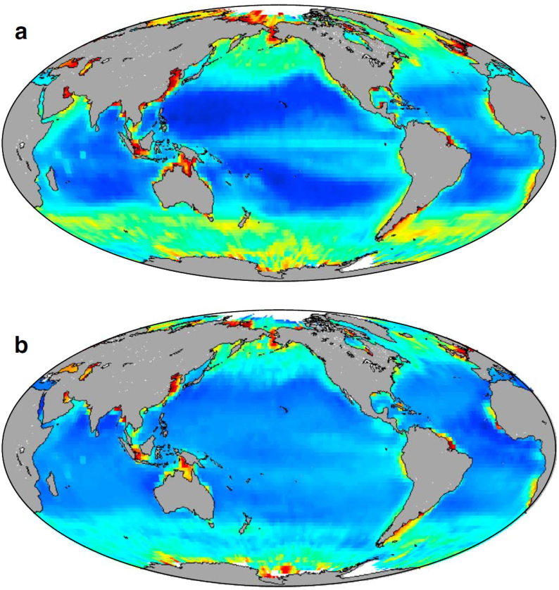
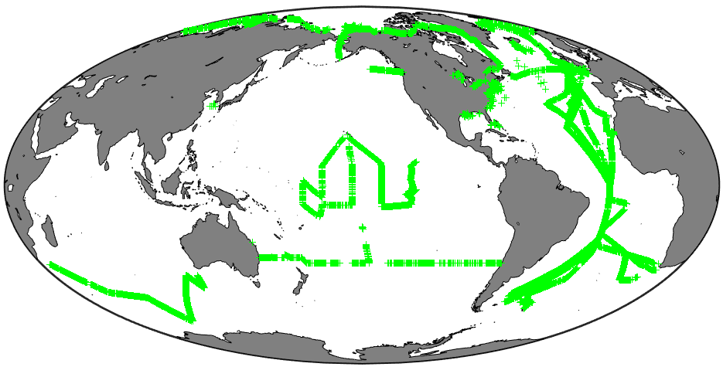
Plankton Stocks with a Satellite Lidar
lidar
CALIOP
MODIS GSM
MODIS QAA
ocean color
Frequency
Particulate organic carbon (mg m⁻³)
Phytoplankton Carbon (mg m⁻³)
Behrenfeld et al. 2013 Geophys. Res. Lett. 40, 4355-4360

Slide 20
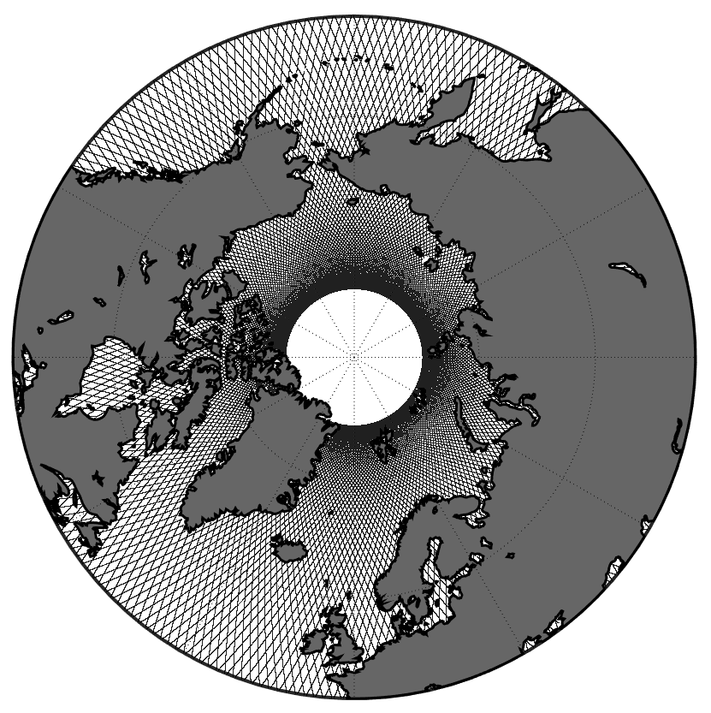
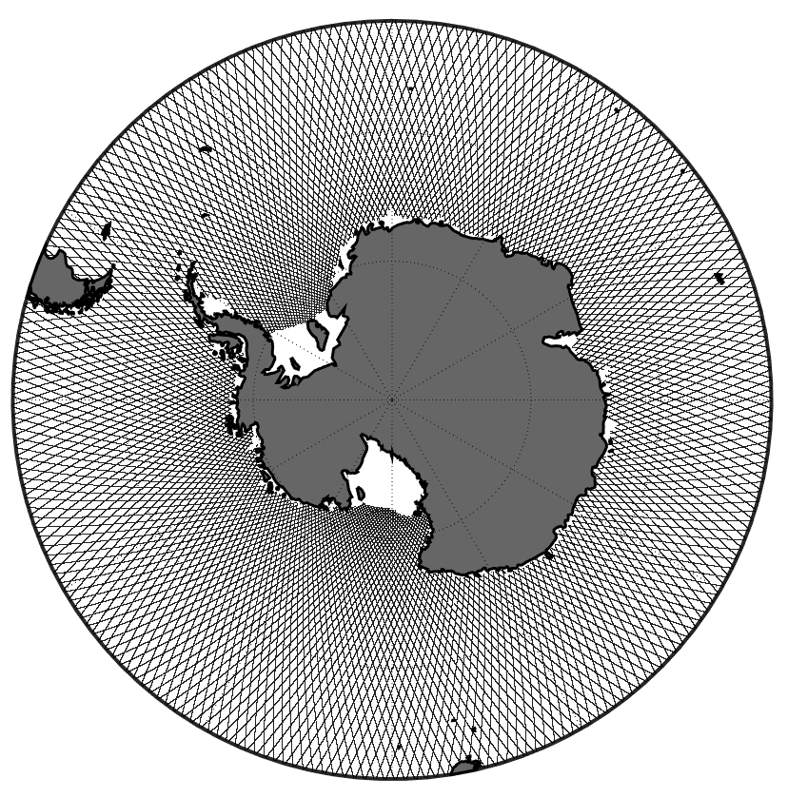
Polar Systems: Where Lidar Really Shines
Behrenfeld et al. 2016 Nature Geoscience 19, 118-122
Notes:
<number>

Slide 21
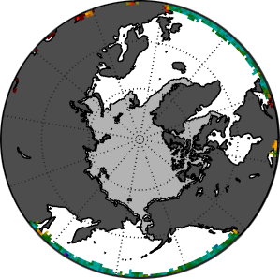
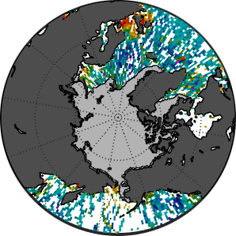
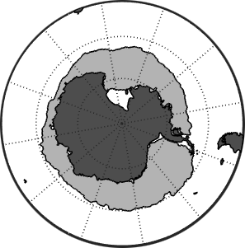
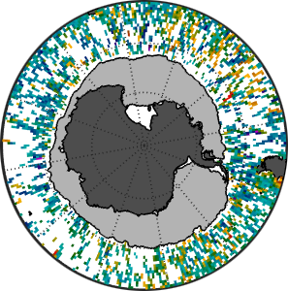
CALIOP Shines on Polar Ecosystems
50
Phytoplankton
biomass (mg C m³)
25
December 2010
comparison zone
0
MODIS
CALIOP
2007
2009
2011
2013
2015
Year
MODIS biomass
CALIOP biomass
50
Phytoplankton
biomass (mg C m³)
25
June 2010
comparison zone
MODIS
CALIOP
0
2007
2009
2011
2013
2015
Year
10
20
40
80
100
Phytoplankton Biomass (mg C m⁻³)
Behrenfeld et al. 2016 Nature Geoscience 19, 118-122

Slide 22
CALIOP Shines on Polar Ecosystems
50
Polar Zone
25
December 2010
comparison zone
Phytoplankton
biomass (mg C m³)
MODIS
CALIOP
75
50
25
0
2007
2009
2011
2013
2015
MODIS biomass
CALIOP biomass
Year
50
Polar Zone
25
June 2010
comparison zone
MODIS
CALIOP
Phytoplankton
biomass (mg C m³)
50
25
0
2007
2009
2011
2013
2015
10
20
40
80
100
Year
Phytoplankton Biomass (mg C m⁻³)
Behrenfeld et al. 2016 Nature Geoscience 19, 118-122

Slide 23
Polar Biomass Dynamics
North Polar Zone
0.01
biomass rate
of change (d⁻¹)
0
-0.01
Jan
July
Jan
Month
Behrenfeld et al. 2016 Nature Geoscience 19, 118-122

Slide 24
Polar Biomass Dynamics
North Polar Zone
0.01
biomass rate
of change (d⁻¹)
0
Now consider the derivative of this annual cycle…
-0.01
maximum increase rate
initial rise
maximum
termination
decrease rate
1
division
rate (d⁻¹)
0.5
0
Jan
July
Jan
Month
Behrenfeld et al. 2016 Nature Geoscience 19, 118-122

Slide 25
Polar Biomass Dynamics
North Polar Zone
biomass rate
of change (d⁻¹)
division rate
of change (d⁻²)
0.01
0
-0.01
Jan
July
Jan
Month
The temporal lag in predator (zooplankton, viruses, etc) responses to phytoplankton division rate changes causes the annual cycle in biomass to track accelerations and decelerations in division rate
Behrenfeld et al. 2016 Nature Geoscience 19, 118-122

Slide 26
Summary
CALIOP fortuitously circumvented what is the death of many good ideas … proof-of-concept in space
CALIOP’s global observations provide independent assessments of plankton stocks and new constraints for ocean color algorithms
CALIOP’s polar observations address major challenges for ocean color sensors, ‘fill in’ missing pieces of plankton annual cycles, and provide new ecological insights on plankton ‘boom-bust’ cycles

Slide 27
The lidar era in satellite oceanography has arrived…

Slide 28
Solving a problem

Slide 29
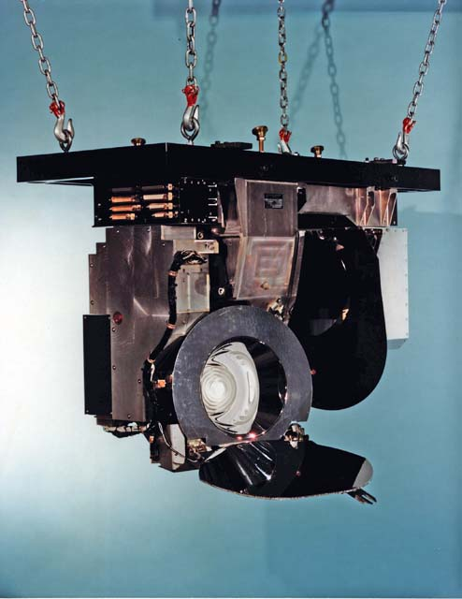
‘Proof-of-Concept’
CZCS
Notes:
CALIOP is an atmospheric sensor and NOT a blueprint for future ocean lidars
<number>

Slide 30
Simple Elastic Backscatter Lidars (e.g., CALIOP)
An ‘ill-posed problem’: 1 measurement (attenuated backscatter), 2 unknowns (b_{bp}, k_{d})
Ancillary data and/or bio-optical assumptions required to solve, with large potential errors
Retrieval starts from top of profile and attenuation is removed at each level by assuming an extinction-to-backscatter ratio. Errors accumulate with distance from sensor
Science value will be far greater for a lidar providing independent, calibrated retrievals of b_{bp} and k_{d} without propagation of errors …
… can this be done?

Slide 31
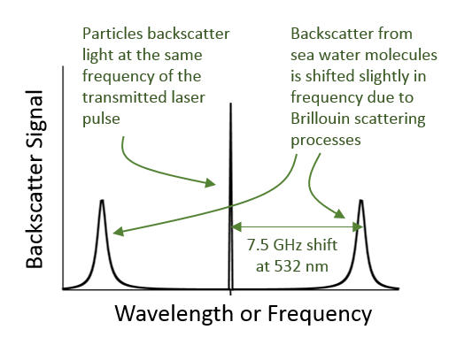
High Spectral Resolution Lidar (HSRL)

Slide 32
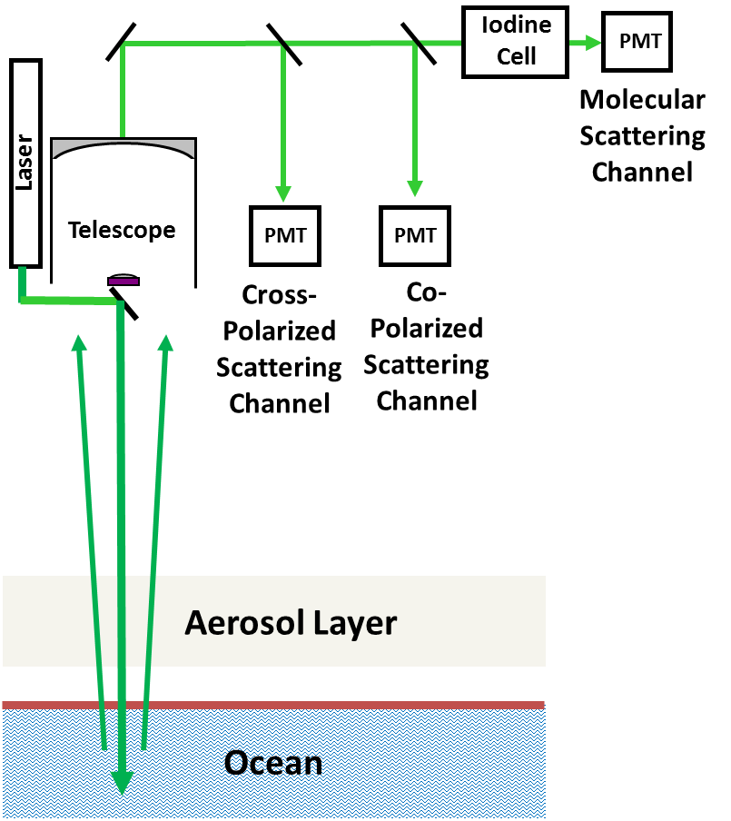
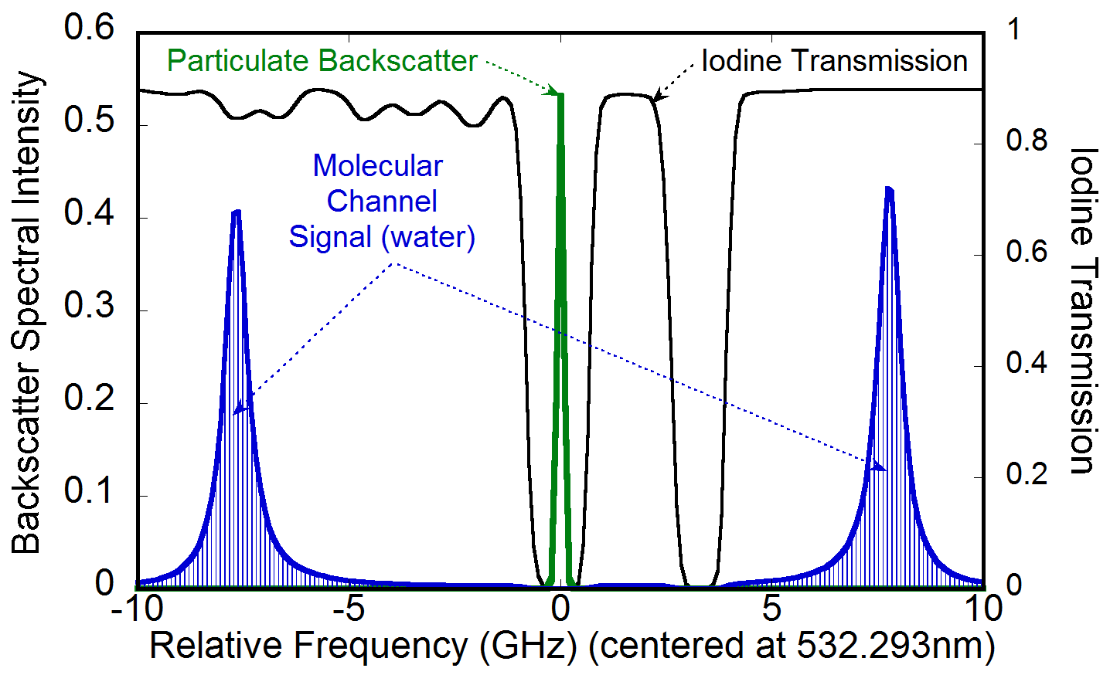
High Spectral Resolution Lidar (HSRL)
Laser tuned to I₂ absorption line
Can also use interferometer
Particulate backscatter blocked from “Molecular Channel”

Slide 33
High Spectral Resolution Lidar (HSRL)
A ‘well-posed problem’: 2 measurement, 2 unknowns (b_{bp}, k_{d})
Notes:
HSRL designs vary from instrument to instrument, but the fundamental approach is the same. We will consider here the simplest of HSRL architectures where there are two detection channels. One of these channels is more sensitive to particulate backscatter from the ocean (the middle peak in Figure 2) and one is more sensitive to molecular backscatter from seawater itself (the right and left peaks in Figure 2). This separation of the backscatter signal is accomplished in the lidar receiver (Figure 1) with a spectral filter (e.g., an interferometer) that has a well characterized frequency response. The two time-resolved signals are combined to form two profiles proportional to backscatter at 180˚. The first of these derived profiles, S_{M}(z), represents photons backscattered by water (β_{M}): where the integral of K_{d} and the square of the atmospheric transmission account for the attenuation that the transmitted and backscattered photons undergo along their optical paths. C_{M} is a channel-specific instrument constant that incorporates factors like laser energy, telescope area, and the efficiency of receiver components. The second profile, S_{P}(z), represents photons backscattered by suspended particles in the ocean (β_{P}) and likewise attenuated by the ocean (K_{d}) and atmosphere: where C_{P} is the instrument constant for the second channel. Because the density of seawater molecules is relatively constant in the near-surface ocean, the value of β_{M} is well known. Thus, the value of K_{d} can be calculated from changes in S_{M}(z) from one depth interval to the next through the water column: Importantly, the influence of K_{d} and atmospheric transmission are the same for S_{P}(z) and S_{M}(z). Consequently, these two terms cancel in the ratio S_{P}(z):S_{M}(z), allowing the attenuation-corrected profile of particulate backscatter at 180˚ to be calculated as: where the only scaling factors required are estimates of β_{M} (well-known) and the C_{M}:C_{P} ratio (which is easily calibrated with high accuracy). β_{P} is then scaled to hemispheric backscatter, b_{bp}, following Boss & Pegau (2001).
In summary, the power of the HSRL technique is that it provides two measurements to solve for two unknowns and requires only relative (i.e., the C_{M}:C_{P} ratio), rather than absolute, calibration. This contrasts critically from the elastic backscatter lidar technique, which provides the combined S_{P}(z)+S_{M}(z) profile only and therefore requires absolute calibration, correction for the atmospheric transmission, and either ancillary data or model assumptions on the relationship between b_{bp} and K_{d} to retrieve either one.
<number>

Slide 34
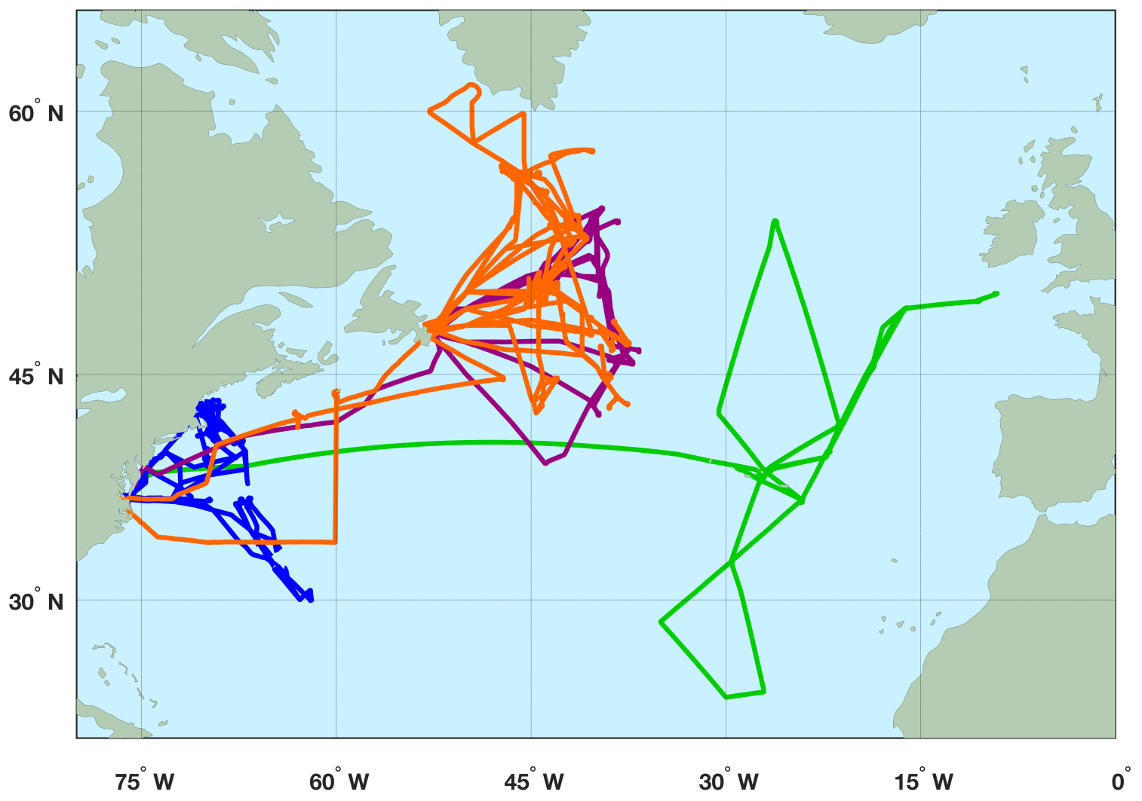
Ocean Retrievals with HSRL
= 2012 Azores/AMT campaign = 2014 NASA SABOR campaign
= 2015 NASA NAAMES 1 campaign = 2016 NASA NAAMES 1 campaign

Slide 35
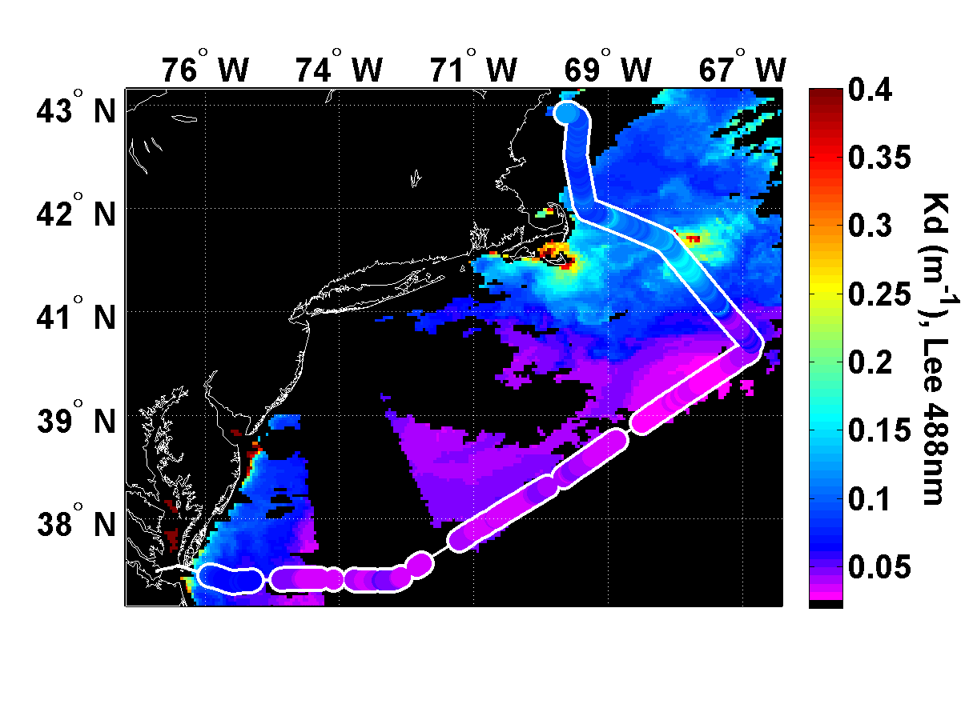
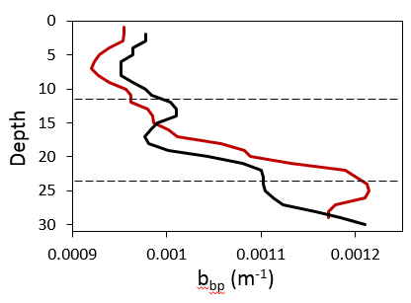
Ocean Retrievals with HSRL
Key Points
Accurate retrievals of b_{bp} and k_{d}
Match-ups have spatial & temporal differences
Accurate retrieval of vertical structure @ 1m resolution
Water column profiling to ~3 optical depths
Improvements in ΣNPP >50% for SABOR (other studies > 100%)
K_{d} (m⁻¹, HSRL)
r = 0.96
K_{d} (m⁻¹, MODIS)
in situ
HSRL
1 optical depth
Depth
b_{bp} (m⁻¹, HSRL)
2 optical depths
r = 0.94
b_{bp} (m⁻¹)
b_{bp} (m⁻¹, in situ)
Data from John Hair (NASA LaRC) & Schulien et al. 2017 Optics Express (in press)
Notes:
Comparison to the semi-analytic (QAA) retrieval by Z. Lee.
Conversion of wavelength only includes the spectral difference in the absorption of water. no other conversions attempted
Number of Flights: 20 over 14 different days
Coincidence: temporally on the same day, lidar data averaged to 4km pixel of satellite.
<number>

Slide 36
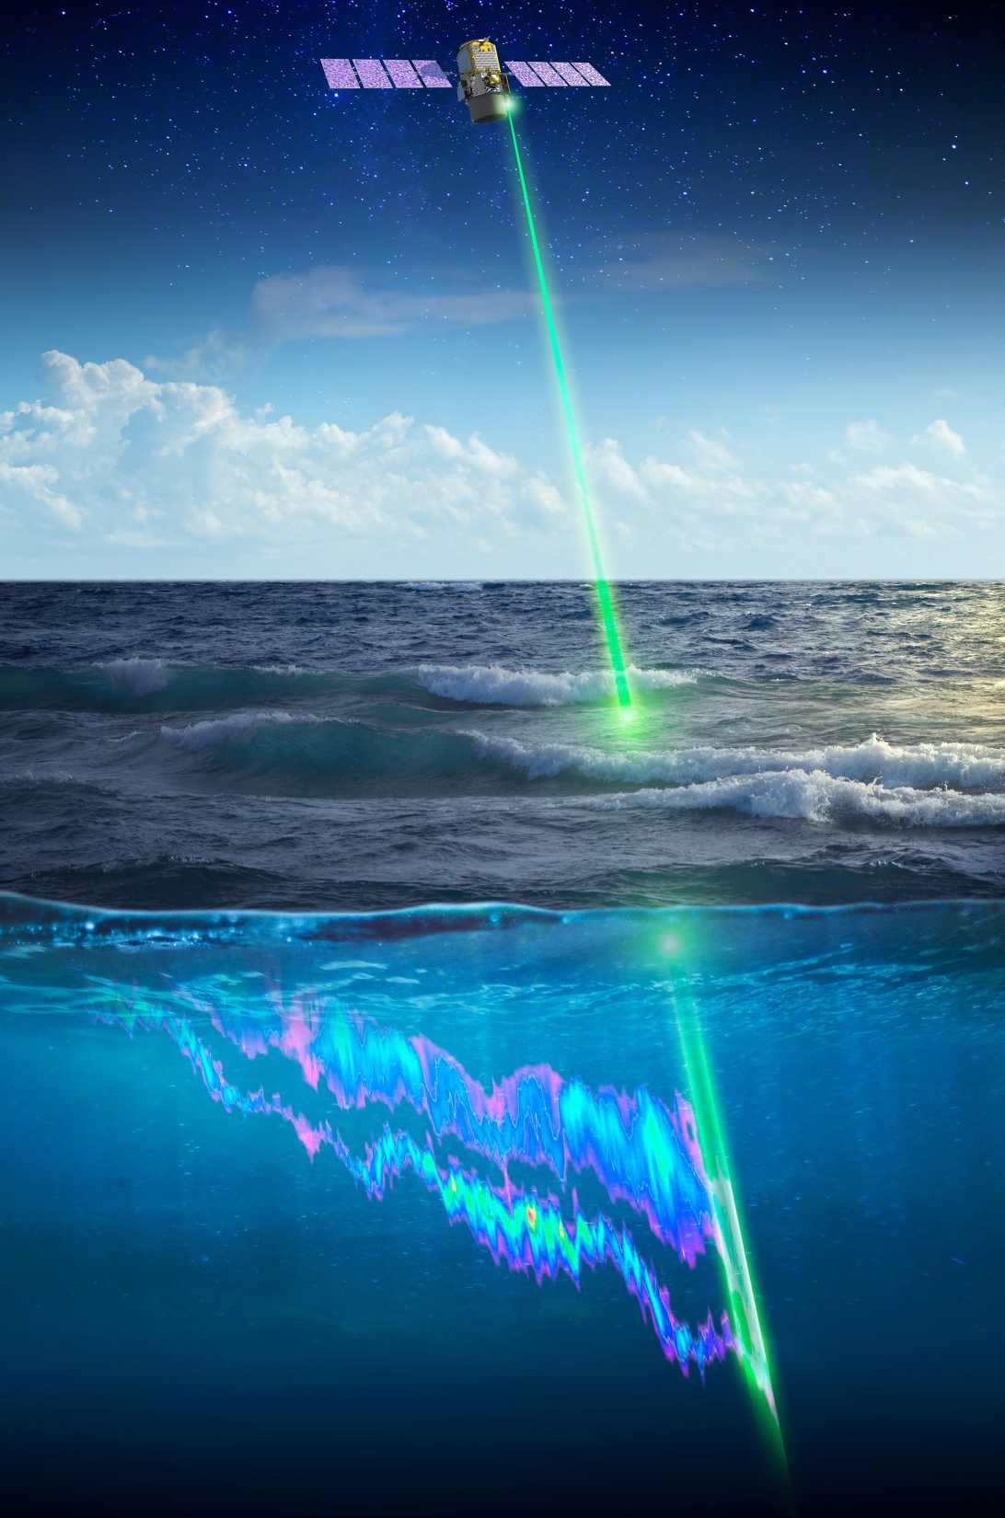
Looking ahead…
… it is time to think about what we can really do with a lidar mission actually designed for ocean retrievals
 subsurface data courtesy of Jim Churnside

Slide 37
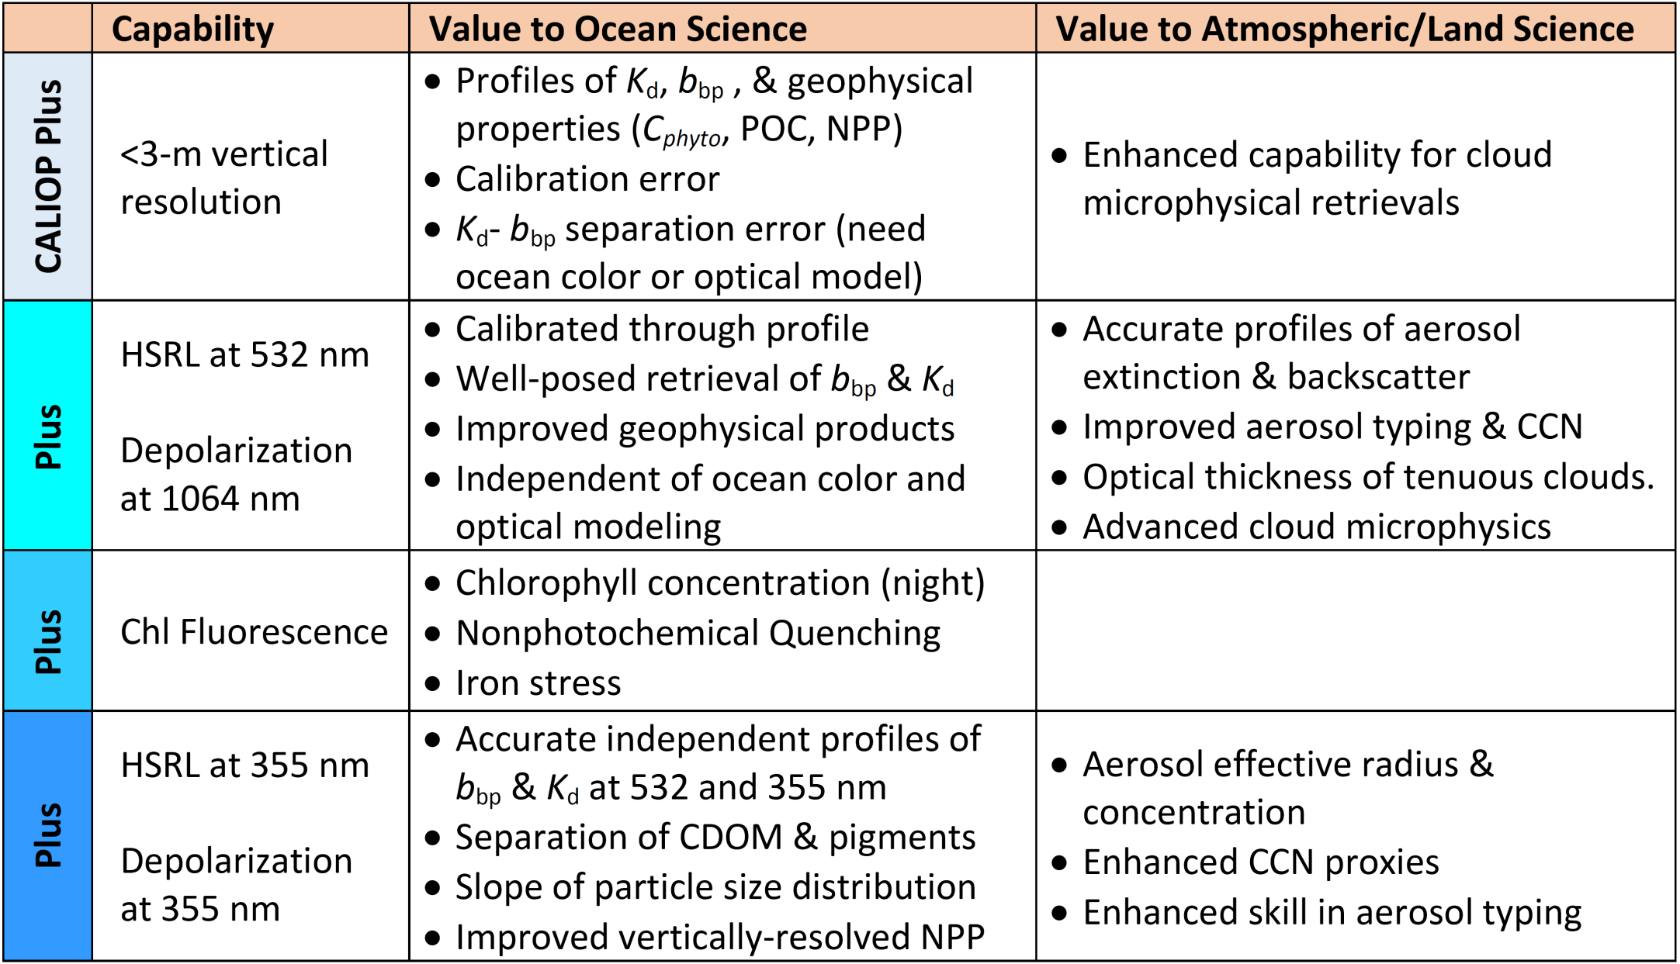
An Ocean-optimized Lidar
Shopping list additions to CALIOP (1064 ‖ / 532 ‖ / 532 / 22 m)
┴
Value to Atmospheric Science
Entry requirement for ocean research
Minimal additional cost to mission

Slide 38
An Ocean-optimized Lidar
Better understanding of polar / other problematic regions
Major improvements in water column phytoplankton stocks (e.g., biomass) and rates (e.g., primary production)
Globally representative data for ocean color algorithm development
New information on physiology (e.g., iron stress, photoprotection)
Ecological insights from day-night stock changes
More accurate ocean color atmospheric corrections
Active mixing depth of the ocean surface layer
& much more…

Slide 39
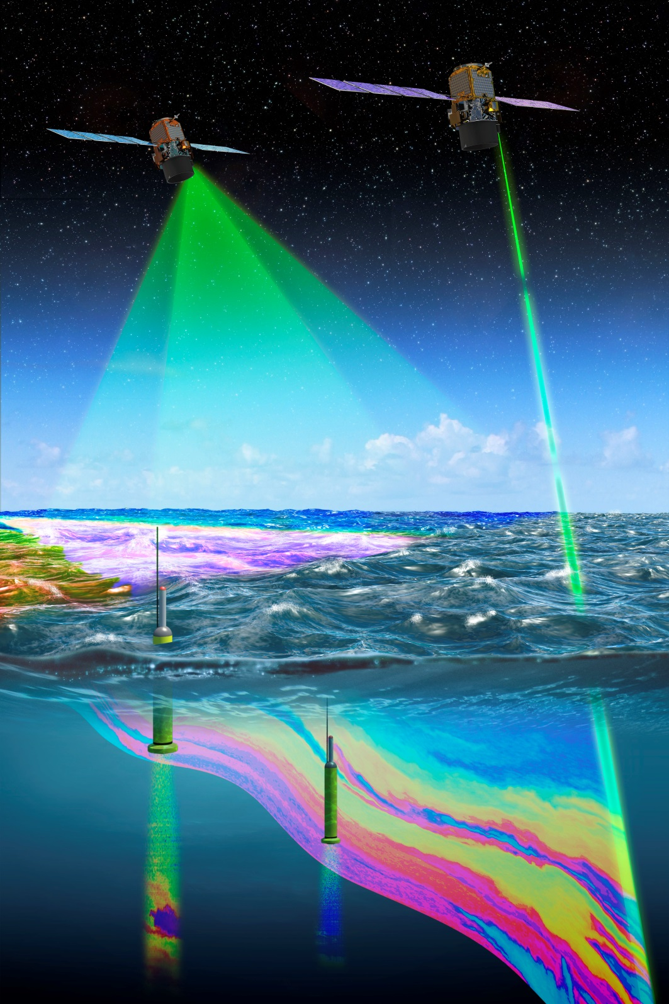
Future Constellation
Enabling a 3-dimensional reconstruction of global ocean ecosystems by combining strengths of different approaches
Optimized ocean-atmosphere lidar
Advanced ocean color sensor
Scanning Polarimeter
Bio-Geo-Argo global array
Achievable in near future (PACE)
MESCAL (Monitoring the Evolving State of Clouds and Aerosol Layers)
CNES concept study partnering
with NASA LaRC

Slide 40
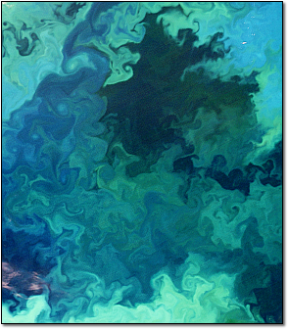
THANK YOU
Chris Hostetler
Yongxian Hu
Johnathan Hair
Jennifer Schulien
Emmanuel Boss
David Siegel
Jorge Sarmiento
Giorgio Dall’Olmo
Sharon Rodier
Charles Trepte
Xiaomei Lu
Amy Jo Scarino
Robert O’Malley
NASA Ocean Biology and Biogeochemistry Program
NASA Earth Science Technology Office
NASA Airborne Instrument Technology Transition Program

Slide 41
Polar Biomass Dynamics
North Polar Zone
South Polar Zone
0.01
0.01
biomass rate
of change (d⁻¹)
0
0
-0.01
-0.01
Jan
July
Jan
July
Jan
July
Month
Month
Behrenfeld et al. 2016 Nature Geoscience 19, 118-122

Slide 42
Polar Biomass Dynamics
North Polar Zone
South Polar Zone
0.01
0.01
biomass rate
of change (d⁻¹)
0
0
Now consider the derivative of this annual cycle…
-0.01
-0.01
maximum increase rate
maximum increase rate
initial rise
maximum
initial rise
maximum
termination
termination
decrease rate
decrease rate
1
1
division
rate (d⁻¹)
0.5
0.5
0
0
Jan
July
Jan
July
Jan
July
Month
Month
Behrenfeld et al. 2016 Nature Geoscience 19, 118-122

Slide 43
Polar Biomass Dynamics
North Polar Zone
South Polar Zone
biomass rate
of change (d⁻¹)
division rate
of change (d⁻²)
0.01
0.01
0
0
-0.01
-0.01
Jan
July
Jan
July
Jan
July
Month
Month
The temporal lag in predator (zooplankton, viruses, etc) responses to phytoplankton division rate changes causes the annual cycle in biomass to track accelerations and decelerations in division rate
Behrenfeld et al. 2016 Nature Geoscience 19, 118-122

Slide 44
355 nm Molecular
Channel
Detec-tor
Detec-tor
355 nm Particulate+Molecular Channel
Interferometer
680 nm Chlorophyll Fluorescence
Channel
532 nm Particulate+Molecular Channel
355 nm Cross-Polarization
Channel
Detec-tor
Detec-tor
Detec-tor
Solar
Background
Filters
Interferometer
Seed
Laser
Solar Background
Filters
Field Stop
Transmitter
Detec-tor
Detec-tor
Detec-tor
Pulsed Laser
1064 nm Cross-Polarization Channel
532 nm Cross-Polarization
Channel
532 nm
Molecular Channel
Telescope
Detec-tor
1064 nm Co-Polarization Channel

Slide 45
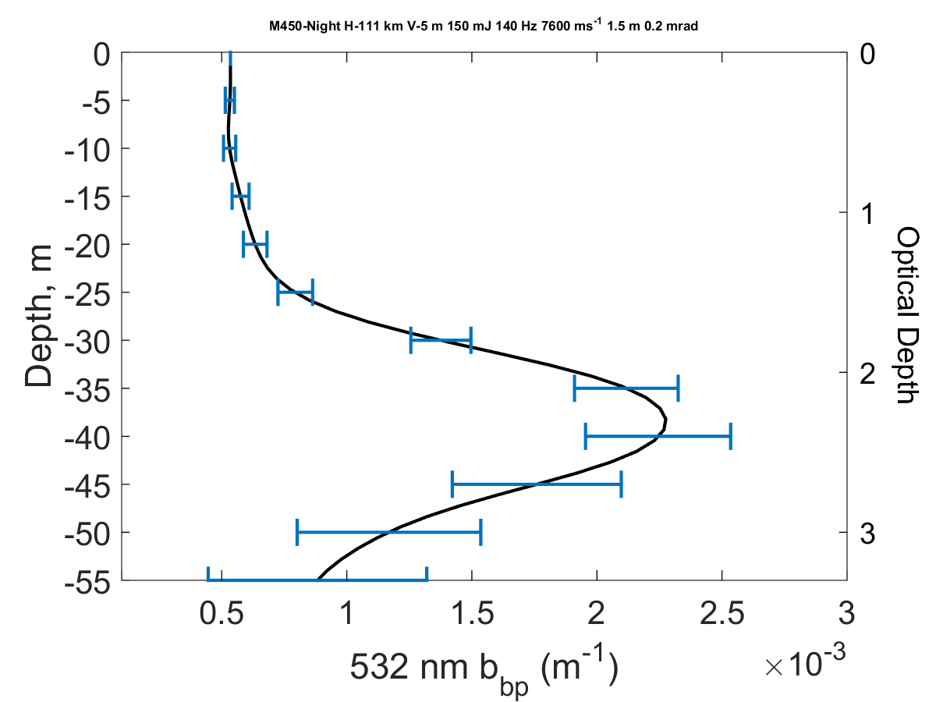
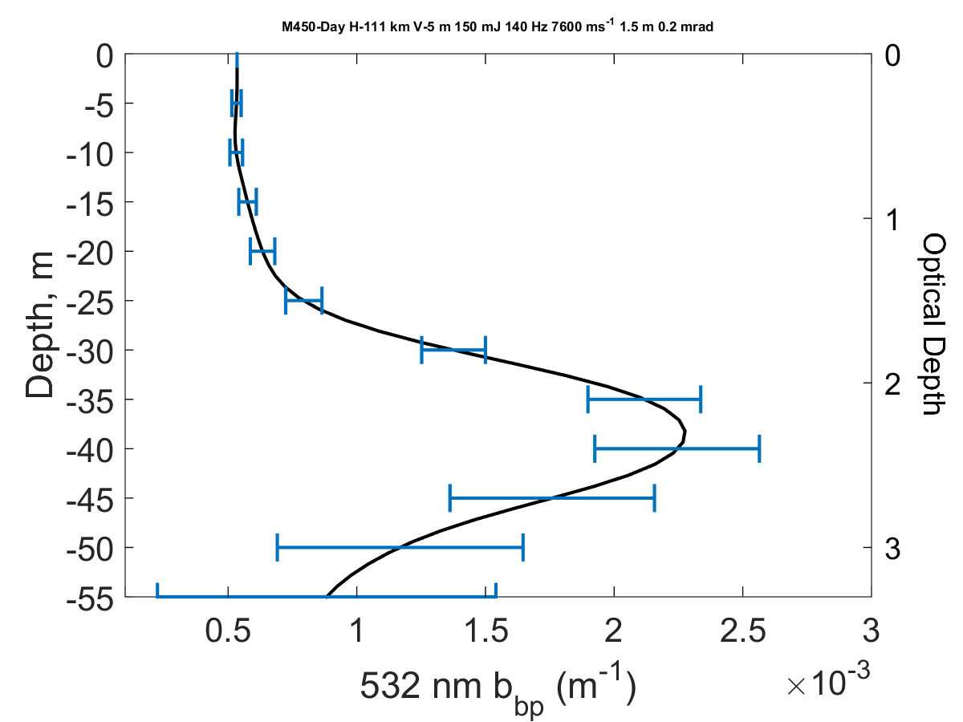
Spaceborne HSRL profiling possible to 3 optical depths
Night
Day
Simulated profiling through 70% of the euphotic zone possible with a realizable system
150 mJ at 140 Hz at 532 nm
1.5 m telescope (similar to ADM-Aeolus)
Altitude 450 km for these simulations
Resolution/precision can be increased via changes in instrument parameters

Slide 46
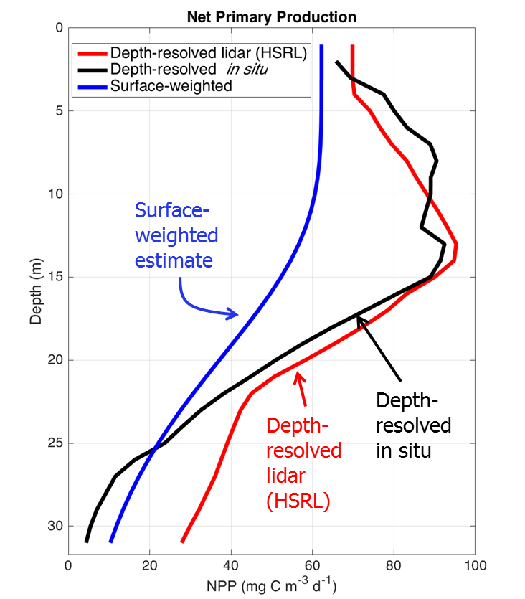
Why do we care about depth-resolved profiles?
Data from the SABOR mission off East Coast US (2104) demonstrating differences between surface-weighted and depth resolved profiles using in situ and HSRL lidar data.
Ocean color style estimates off by as much as 54%
Errors can be much larger in other parts of the ocean
Modified from Schulien et al., Vertically- resolved phytoplankton carbon and net primary production from a High Spectral Resolution Lidar, submitted March 2017.

Slide 47
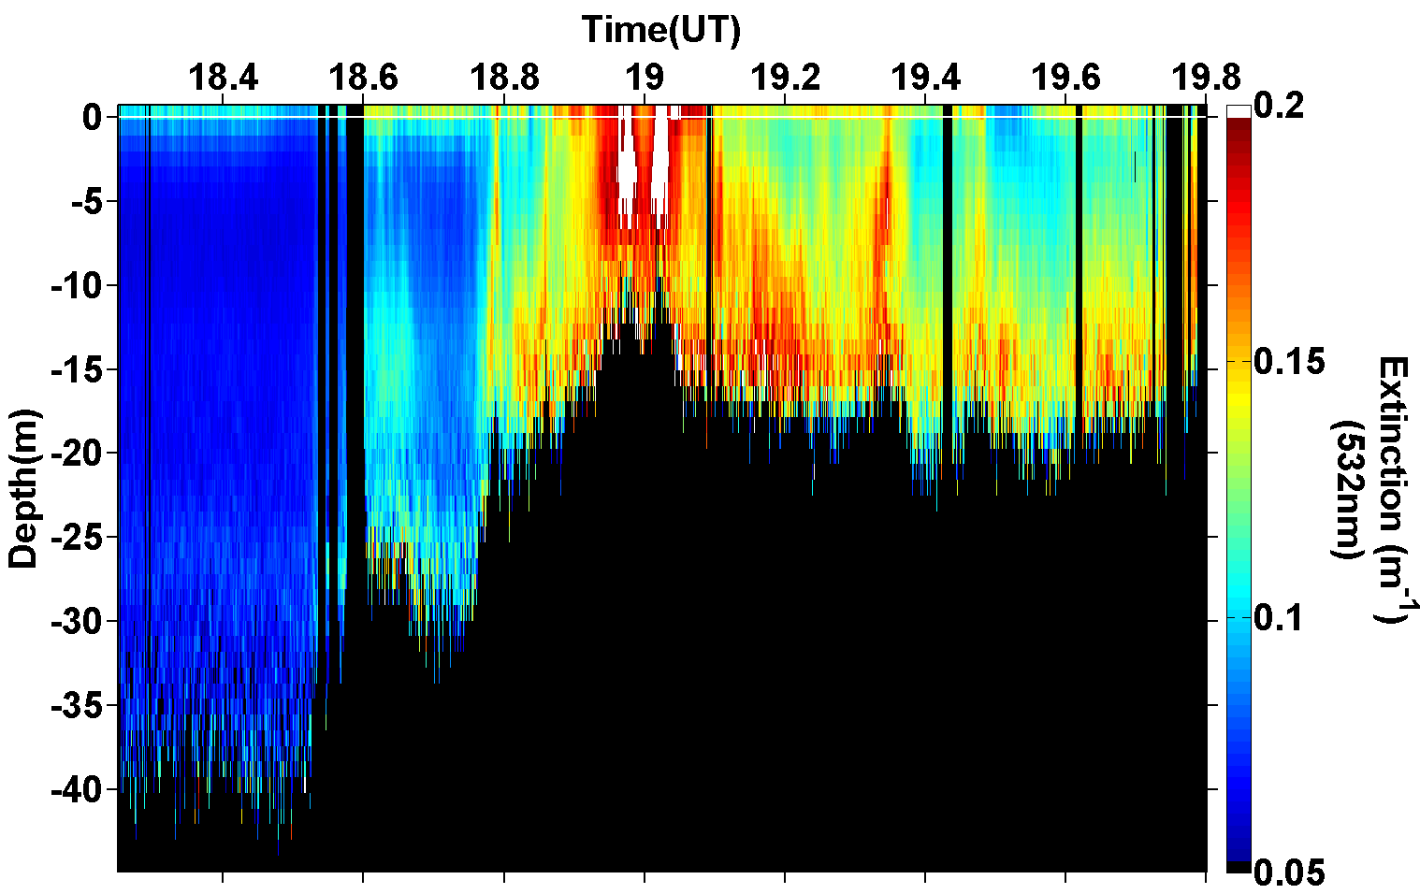
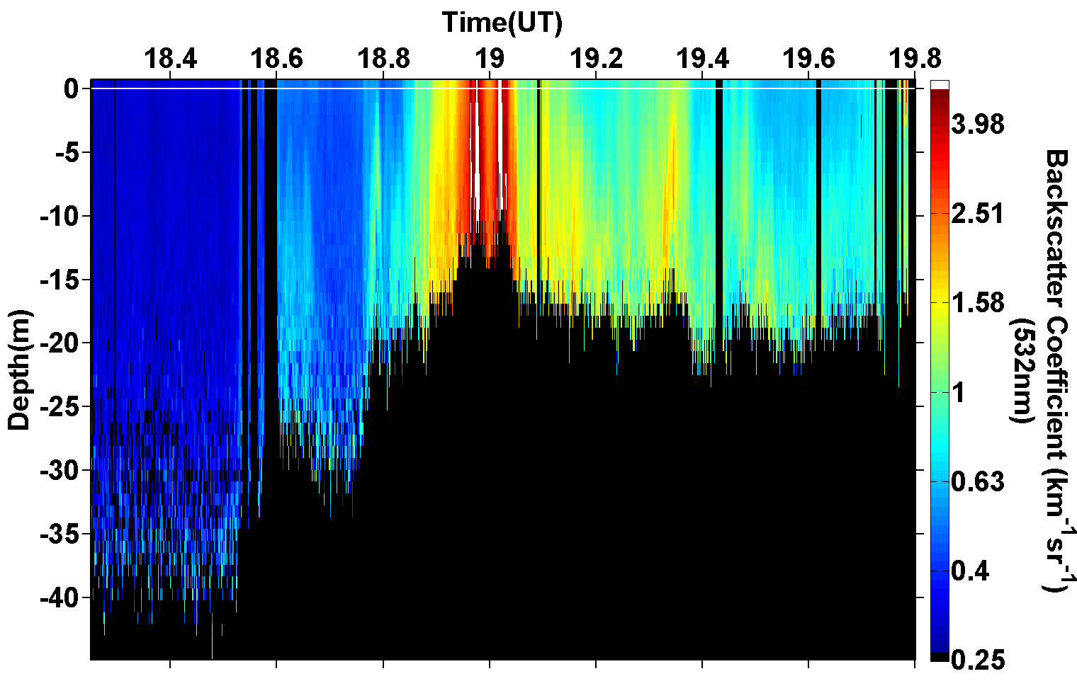
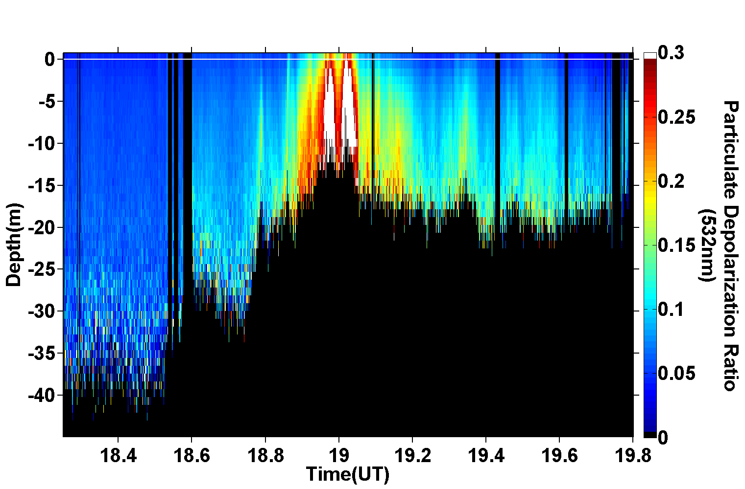
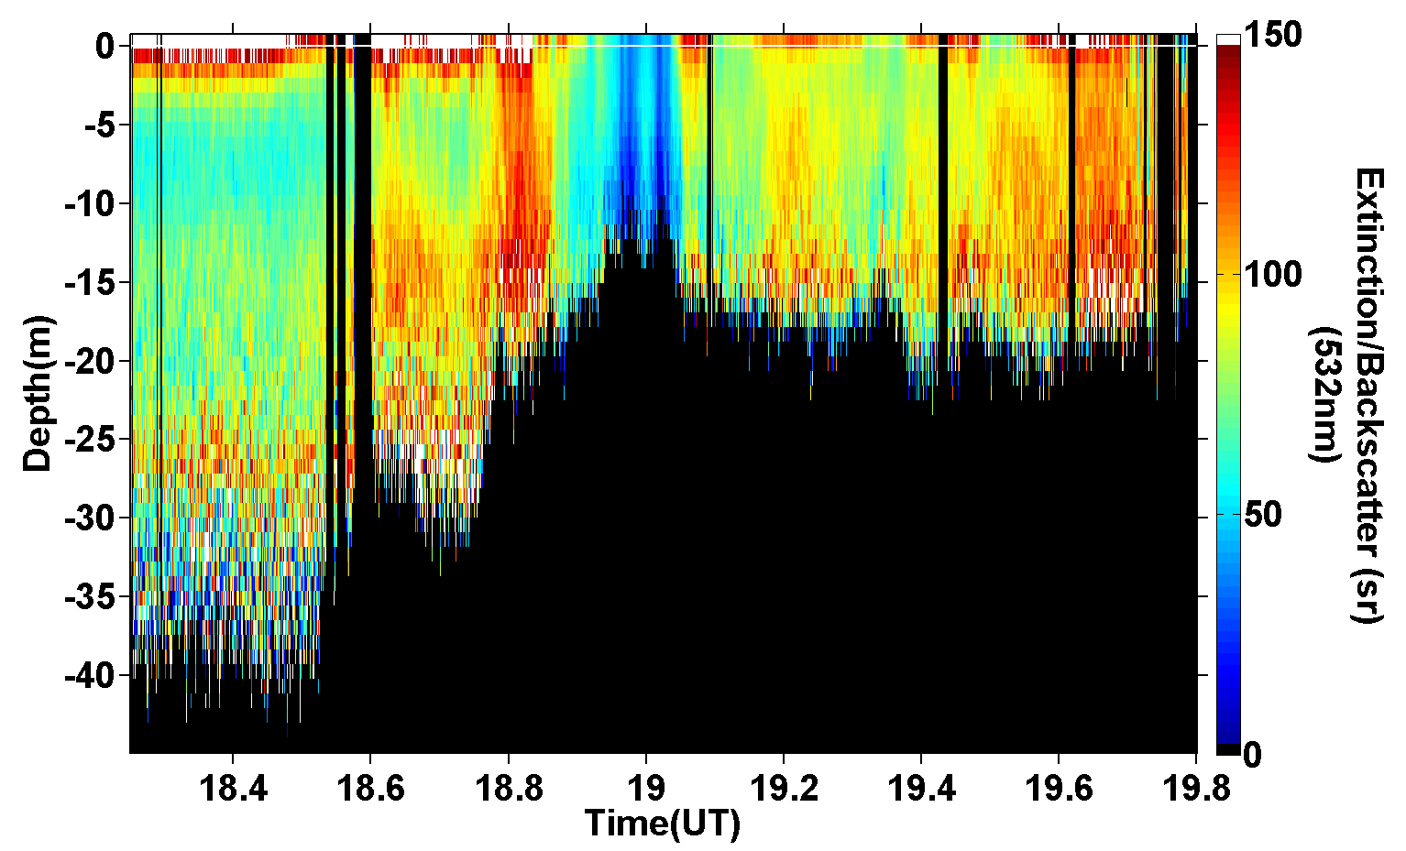
Four ocean products from HSRL-1
Attenuation
~ Kd
Backscatter
Depolarization
Attenuation/Backscatter

Slide 48
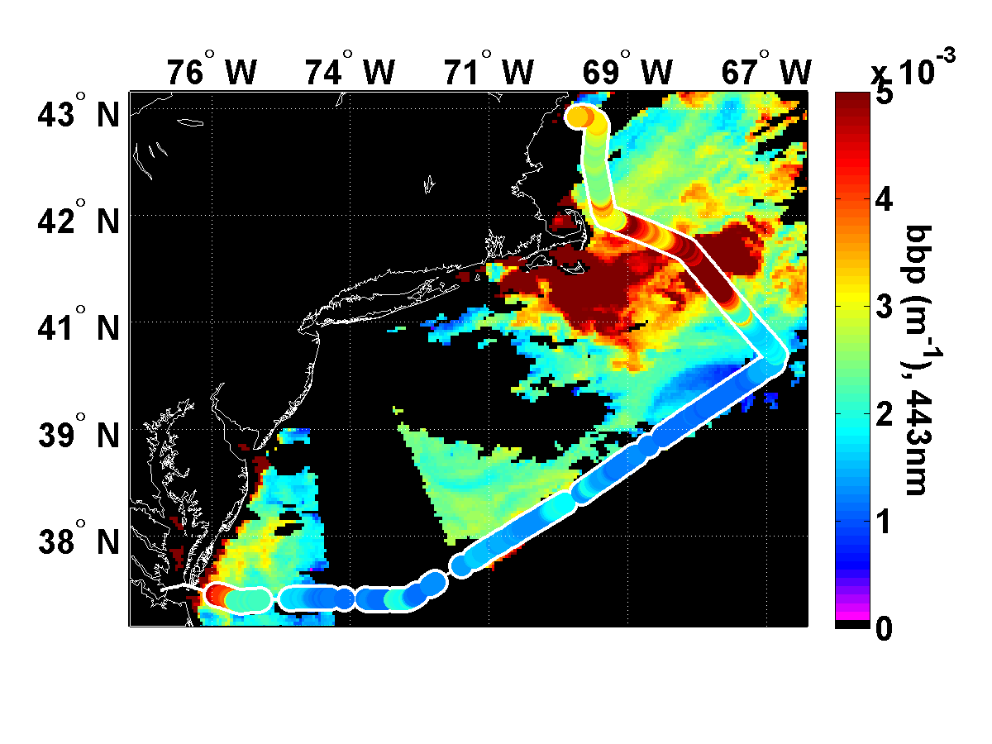

Slide 49
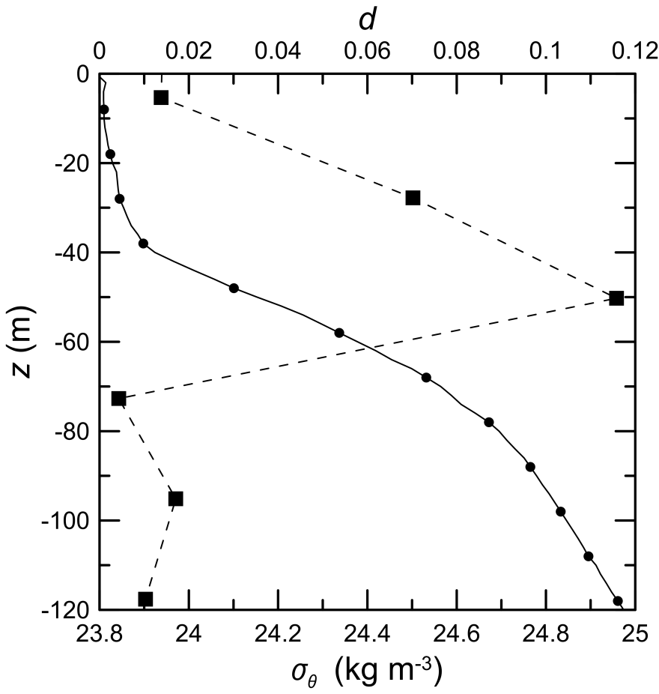
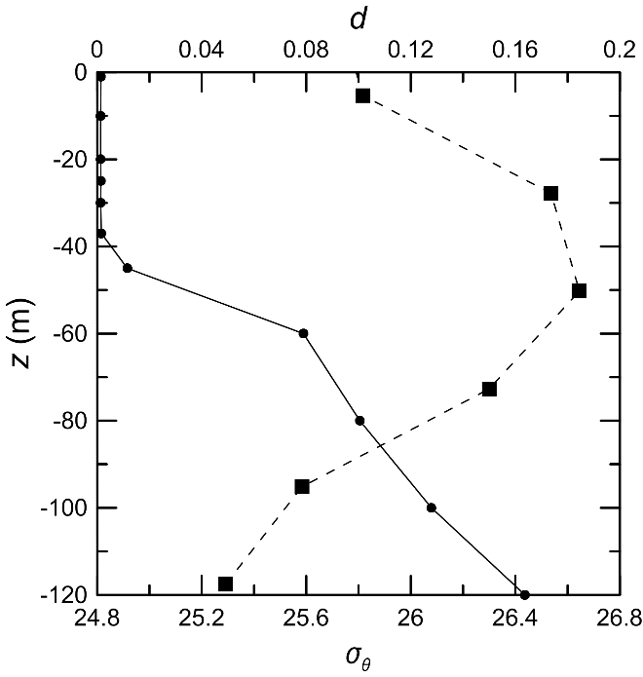
Churnside
Hawaiian Ocean Time Series
Ocean Station P
Profiles of density σ_{θ} (solid line) and lidar depolarization d (dashed line).
Lidar (CALIPSO) depolarization after averaging over 100 shots, 33 km and in-situ density profiles.

Slide 50
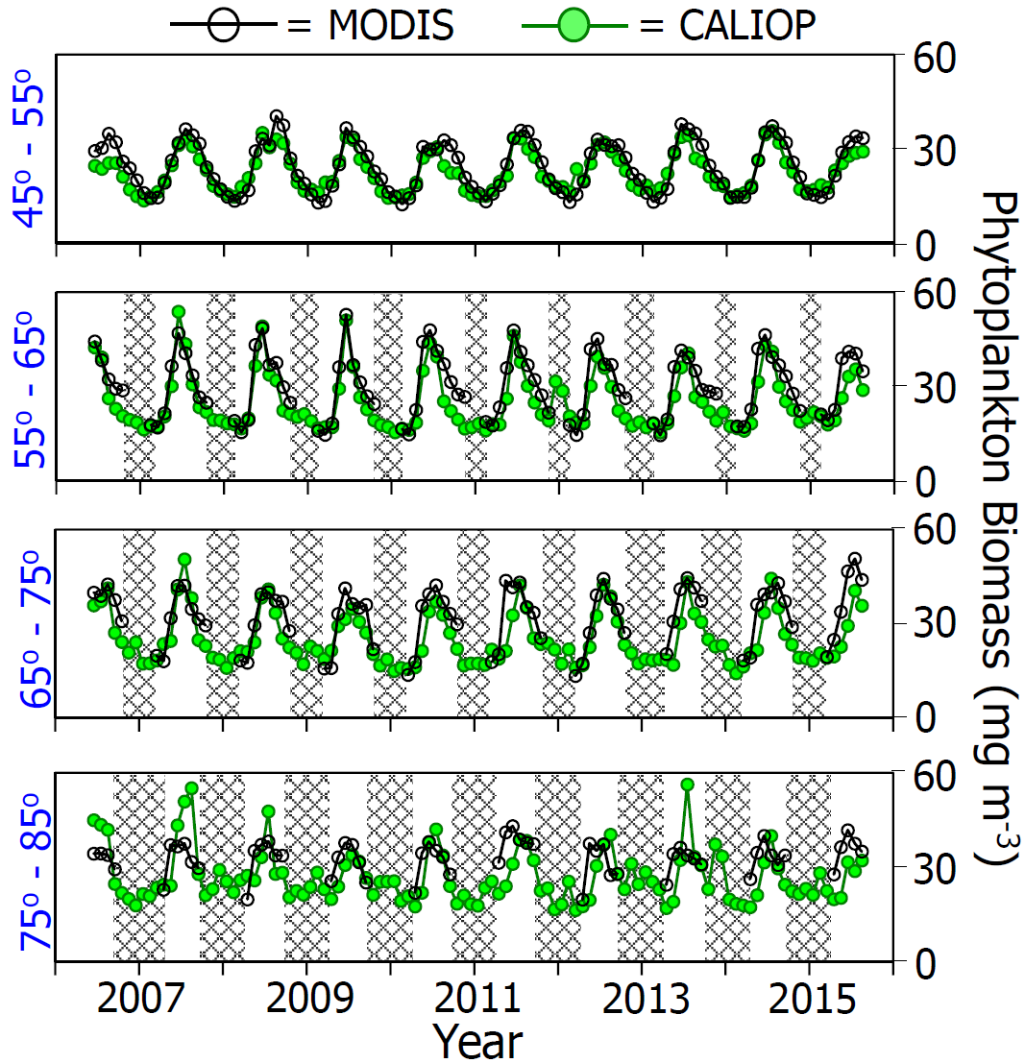
MODIS
65º-75º
75º-85º
55º-65º
45º-55º
CALIOP

Slide 51
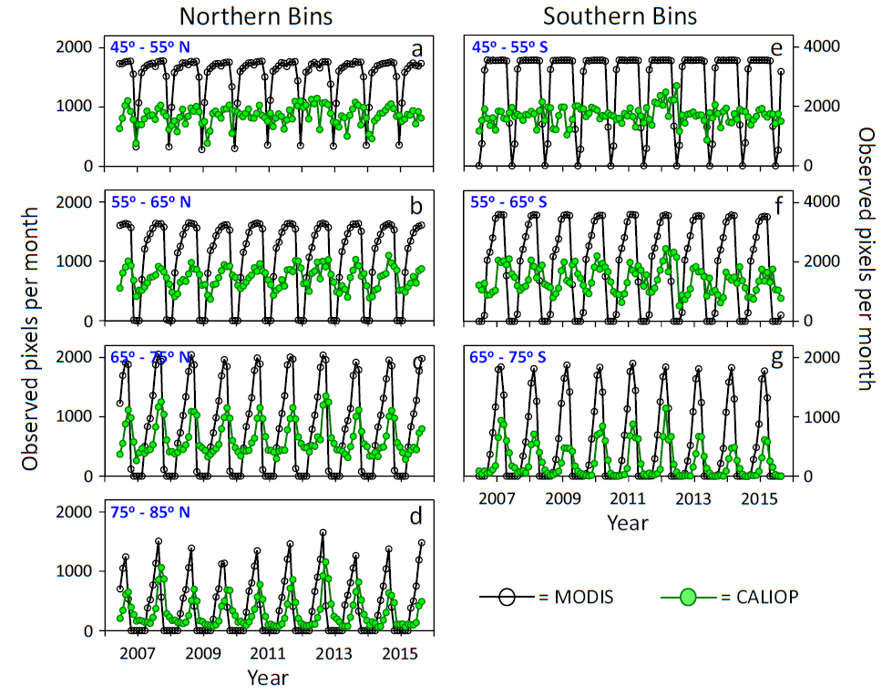
1˚x 1˚ latitude bins with valid b_{bp} retrievals for MODIS and CALIPSO
70% is theoretical max percentage of MODIS pixels sampled by CALIOP

Slide 52
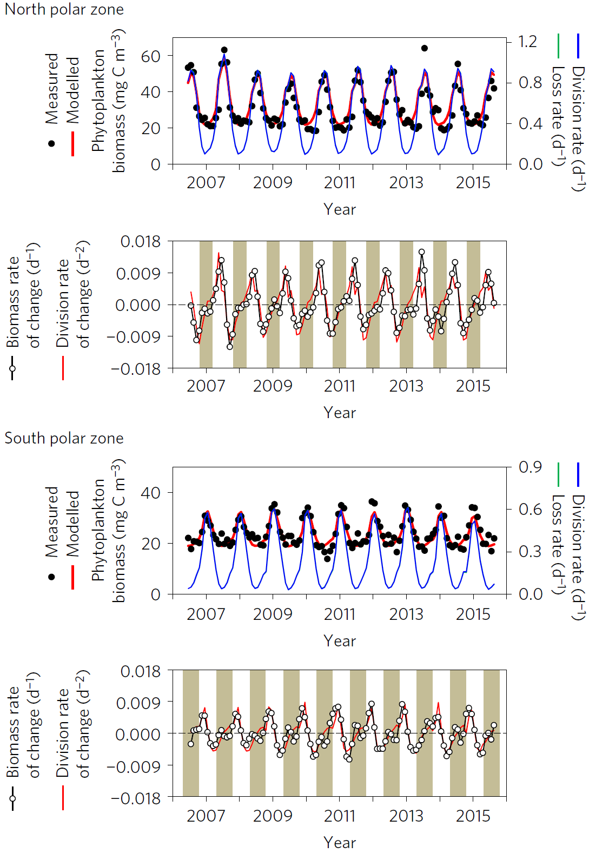

Slide 53
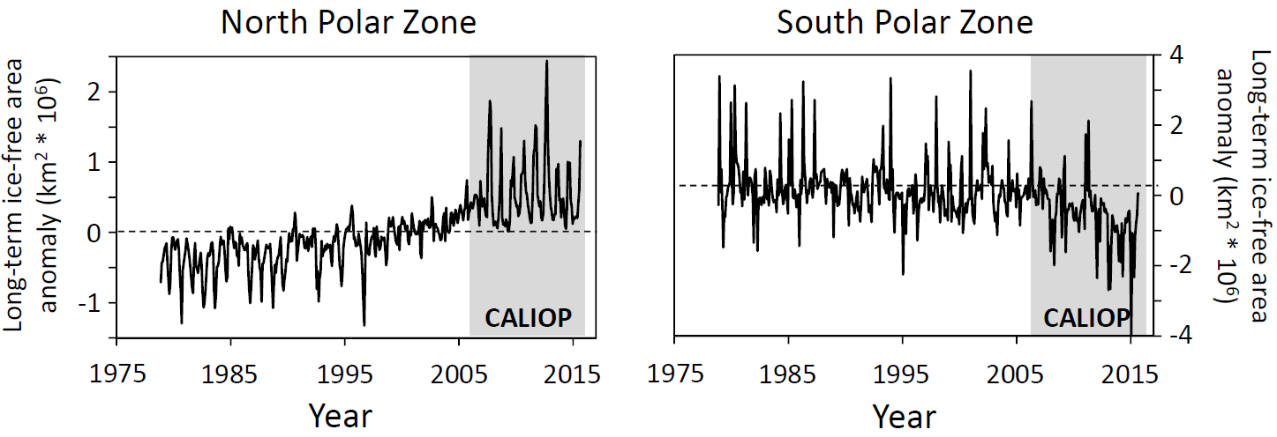
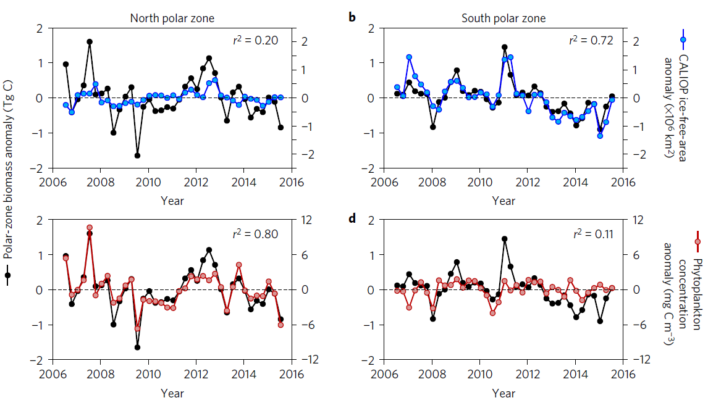
Notes:
6 month anomalies
<number>

