Slide 1
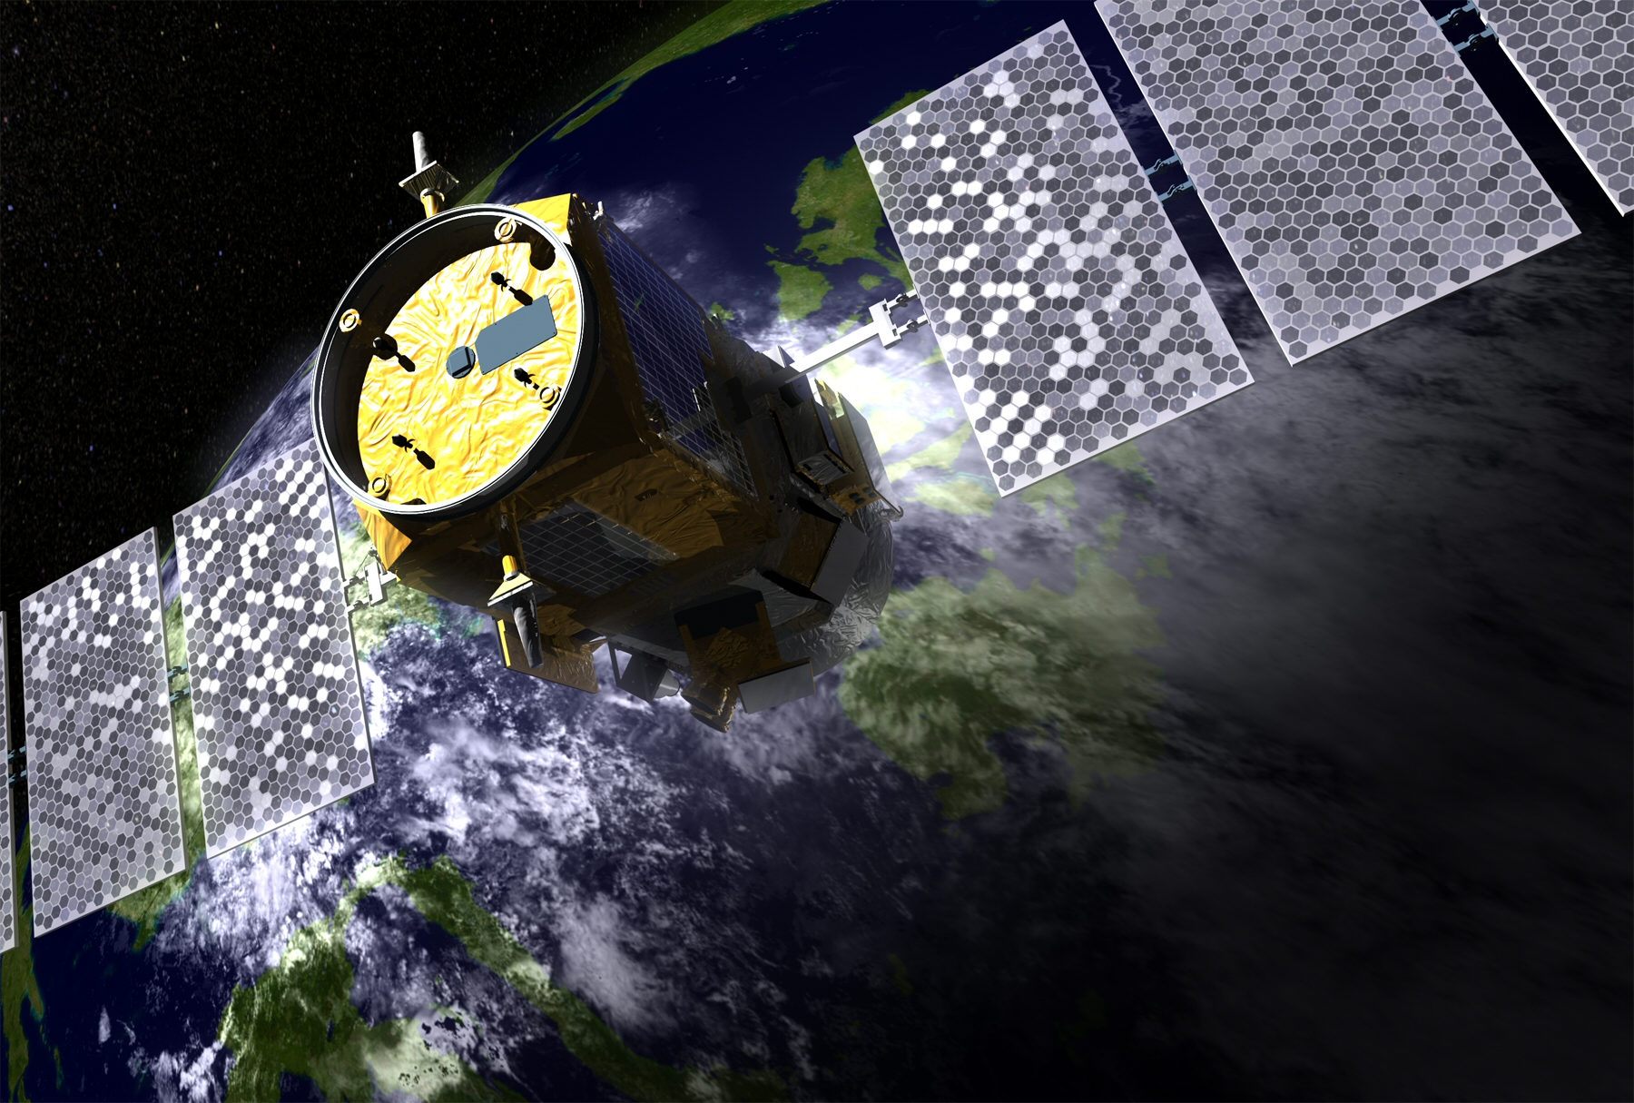
Satellite Lidar Era
in Oceanography
Michael Behrenfeld
Oregon State University
Notes:
<number>

Slide 2
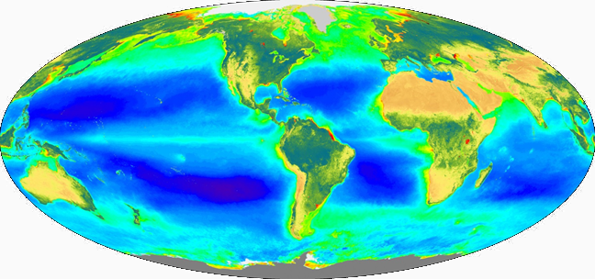
Passive Ocean Color Measurements
A phenomenal tool for understanding and monitoring global ocean plankton ecosystems, but…
atmosphere dominates measured signal and correction is challenging
ocean component of signal dominated by upper ½ optical depth
no direct information on vertical distribution of ocean constituents
global sampling is compromised by aerosols, clouds, solar angle (in the extreme, polar night)
no information on plankton properties at night
difficult to truly validate at the global scale because of poor spatial-temporal coverage of independent field data sets
Notes:
call out errors associated with no veritical information
<number>

Slide 3
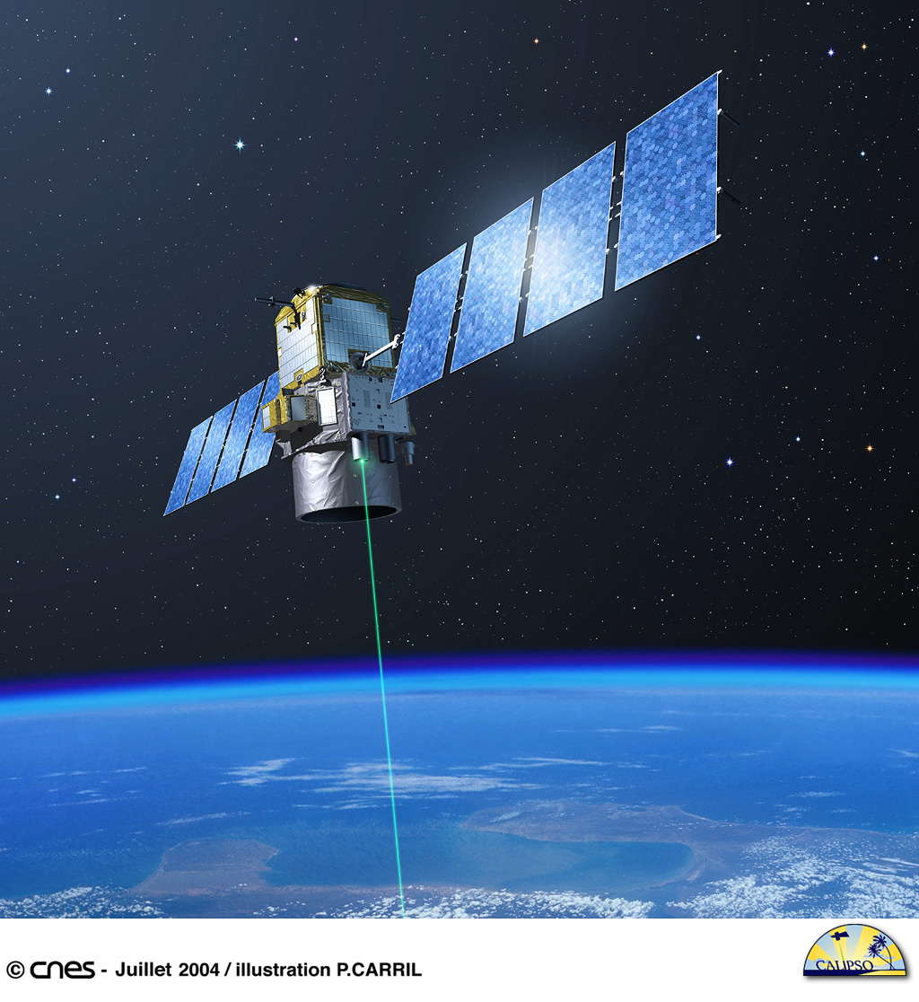
Active Lidar Measurements
Lidar (Light Detection And Ranging)
signal from a known source (laser)
constant viewing geometry
minimal atmosphere correction issues
can resolve vertical structure
valid retrievals through aerosols/thin clouds & between clouds

Slide 4
Active Lidar Measurements
Storyboard:
How does it work?
A little history
A shiny new tool
Migrating animals
Thinking ahead

Slide 5
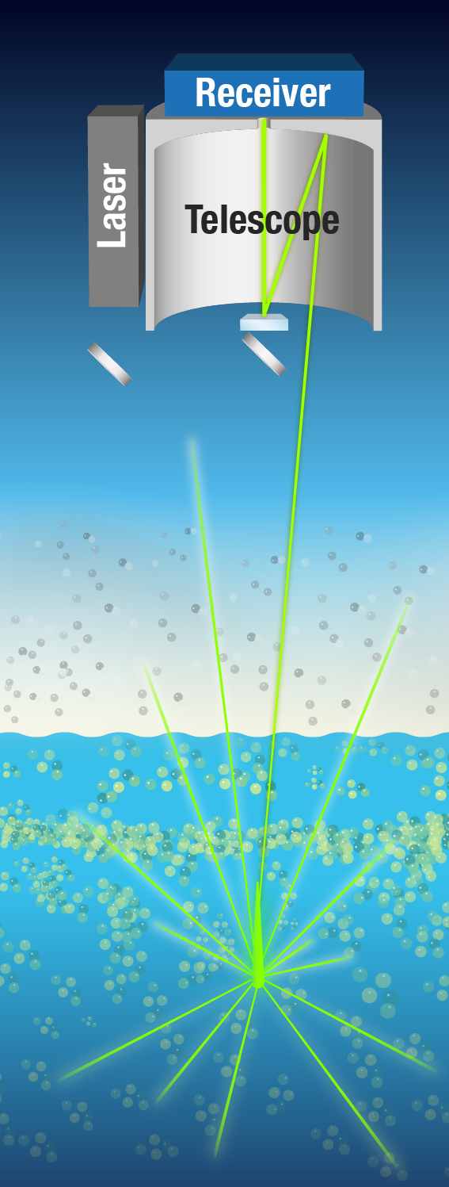
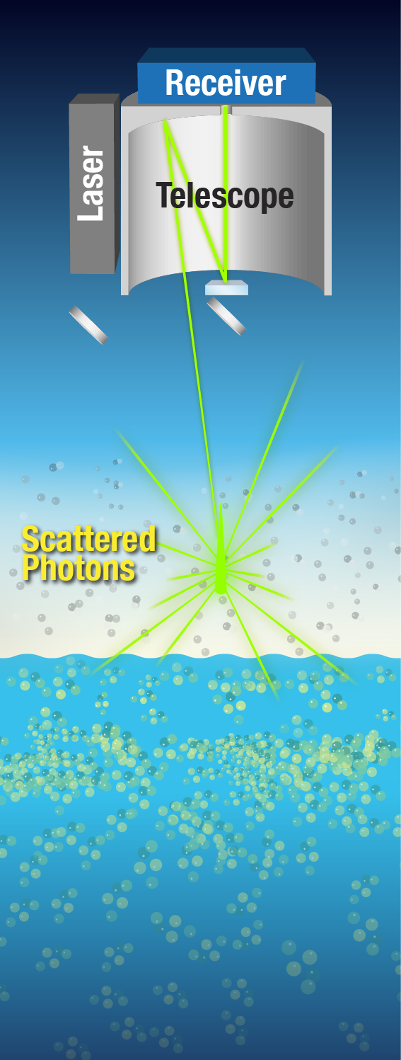
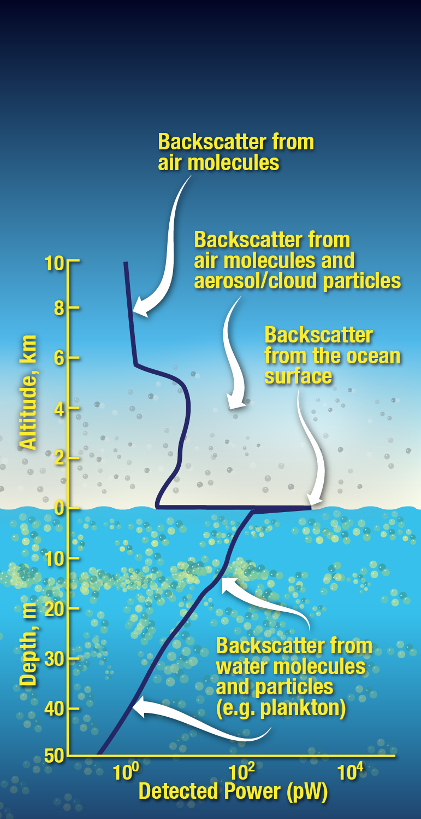
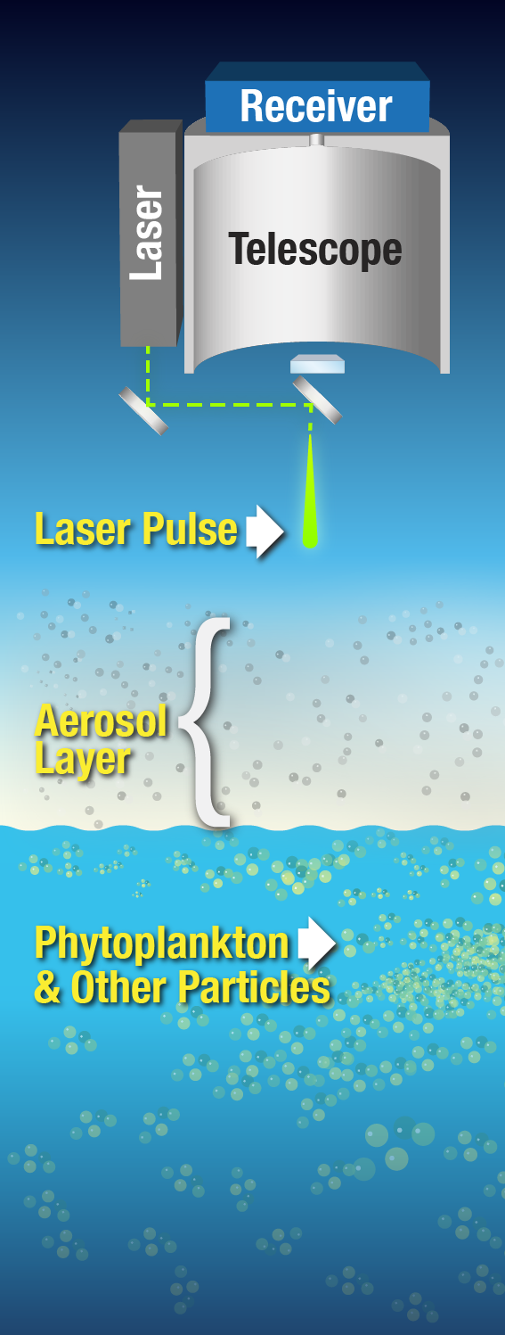
Lidar 101: How does it work?

Slide 6
Active Lidar Measurements
Smoke
The Lidar ‘Curtain’
Chesapeake Bay
Nova Scotia
* note, these data are from an advanced airborne lidar system (discussed later)

Slide 7
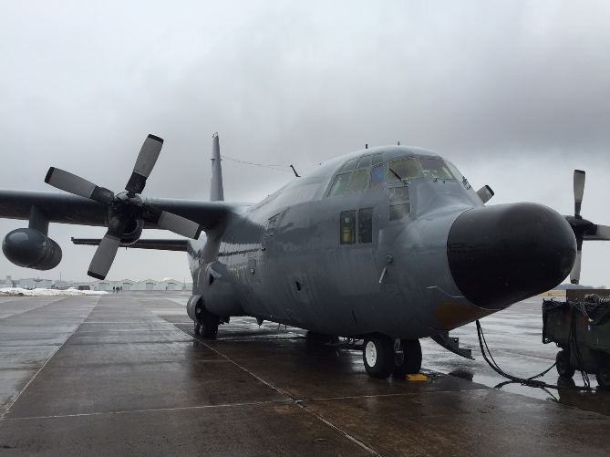
Historical applications: Airborne lidar

Slide 8
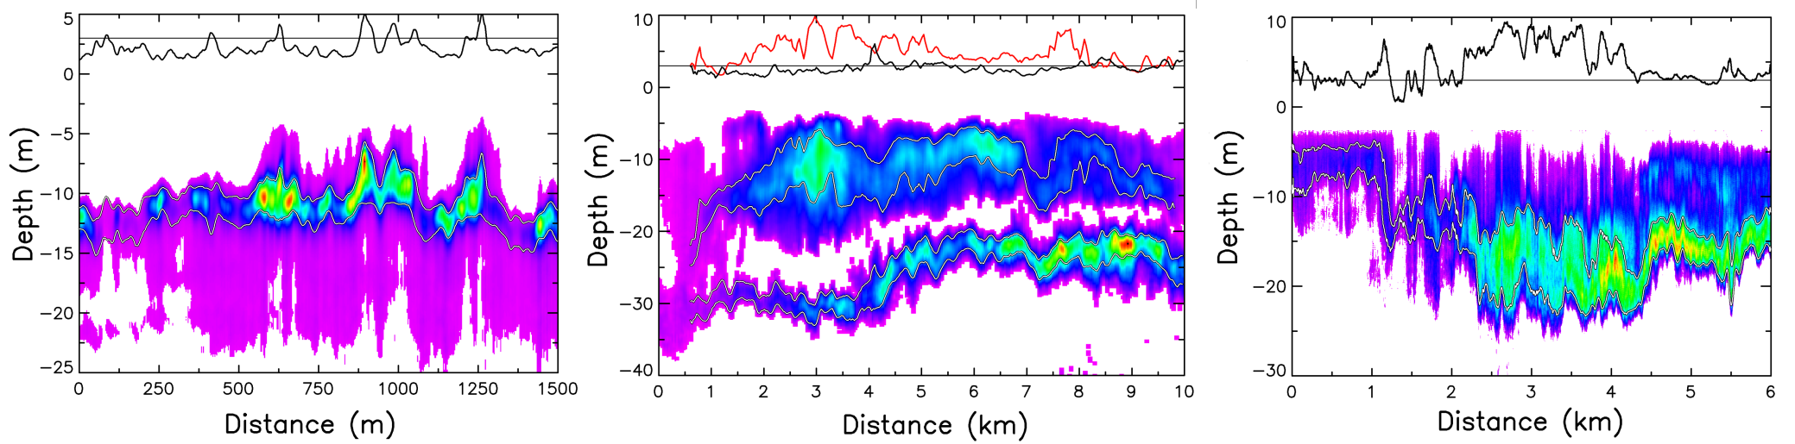
Active Lidar Measurements
Chlorophyll fluorescence (Kim et al. 1973)
Chlorophyll, phycoerythrin, cDOM surveys (Bristow et al. 1981, Hoge et al. 1981, 1986, 1993, 1995, Yoder et al. 1993, Martin et al. 1994)
Water column profiling (Billard et al. 1986, Hoge et al. 1988, Smart & Kwon 1996, Bunkin & Surovegin 1992)
Fish schools & plankton layers (Churnside et al. 1991, 2001, 2003, Churnside & Ostrovsky 2005, Churnside & Donaghay 2009)
Early Airborne Measurements
surface
surface
surface
Notes:
Kim - based at Wallops / instrument flown in helicopter over Ches. Bay and Lake Ontario at 8 m above surface / laser 590 nm / detect @ 685 / results compared to in situ chl
<number>

Slide 9
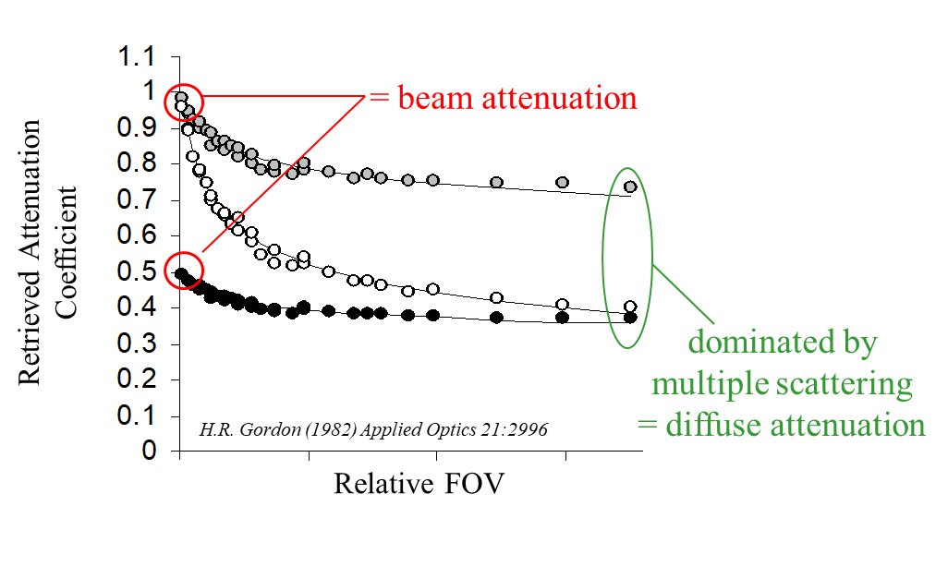
A developing interest…
narrow
wide
…are there any existing data indicating plankton retrievals are possible with a space-based lidar?

Slide 10

Going to Space
Notes:
<number>

Slide 11
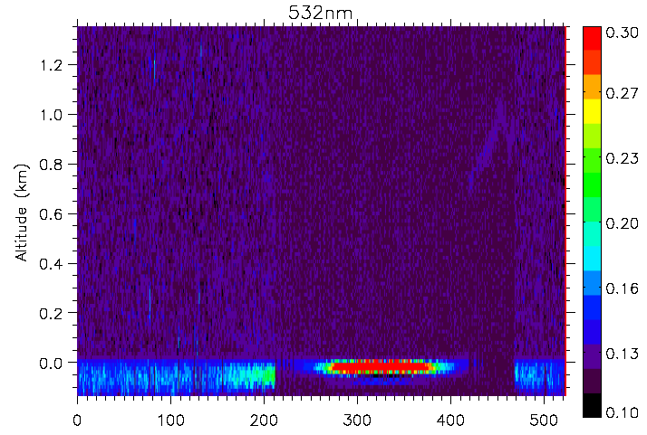
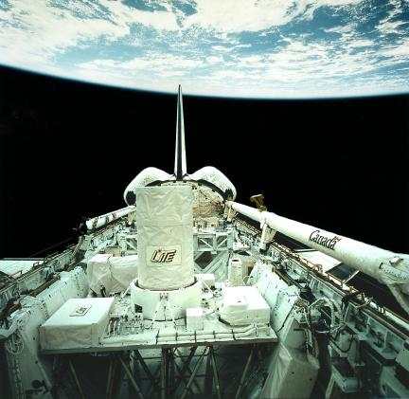
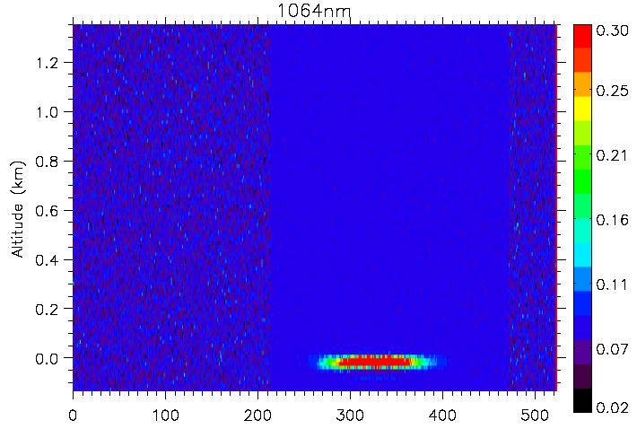
Active Lidar Measurements
Lidar In-space Technology Experiment (LITE)
High Gain
Low Gain
HG
0.6
532 nm
Discovery Space Shuttle in September 1994
3-wavelength Nd-Yg laser
1064 = 486 mJ; 532 = 460 mJ; 355 = 196 mJ
Multi-angle (+/-30⁰) maneuvers over Lake Superior and Gulf of California
0.4
height
0.2
0
ocean surface
15⁰
15⁰
0.6
40
1064 nm
0.4
30
Off-Nadir Angle
height
20
0.2
10
ocean surface
0
0
Time
time
Notes:
<number>
Lite: first real atmospheric lidar measurements from space
High power: 1064 = 486 mJ; 532 = 460 mJ; 355 = 196 mJ
10 Hz

Slide 12
two important things happened next…

Slide 13
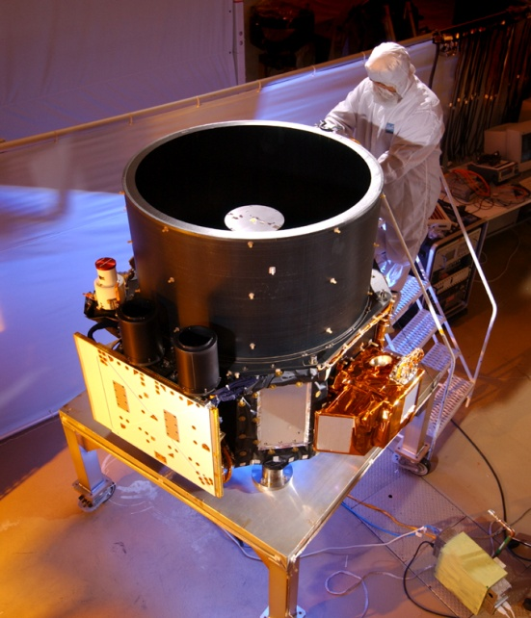
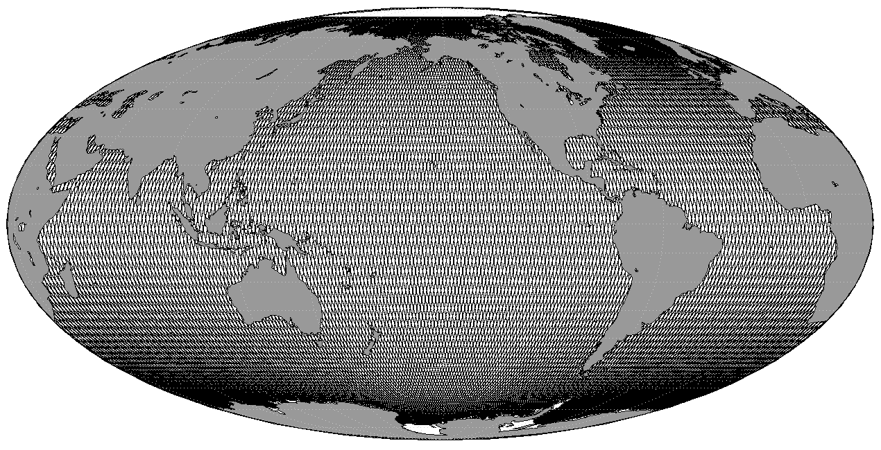
Proof-of-Concept
#1. Cloud-Aerosol Lidar with Orthogonal Polarization
(CALIOP)
NASA-CNES partnership
launched April 28, 2006, still active
definitively NOT designed for ocean applications
2-wavelength 110 mJ Nd:Yg laser (532, 1064 nm)
3-channel (532‖, 532 ┴ , 1064 nm)
1 meter telescope
100 m footprint
30 m air / 23 m water vertical resolution
precessing polar orbit, 16 day repeat
(ask me later if you want to see this)
lasers
Notes:
<number>

Slide 14

Proof-of-Concept
#2. Yongxiang ‘Yong’ Hu
Notes:
used deplolarization ratio (vertically integrated to polarization ratio) estimated what the contribution was fromsurface reflection, then used cloud sat or wind data to remove surface problem
surface flash and calibration of data (goes through the atmosphere)
-depolariation ratio is very well calibrated
- LOOK AT SUPPLEMENT OF MY 2013 PAPER TO UNDERSTAND THIS
<number>

Slide 15
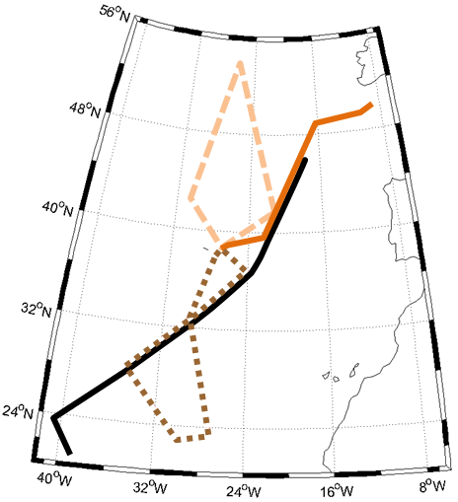
Proof-of-Concept
2012
Ship in situ
CALIOP
MODIS GSM
16:00
14:00
13:00/
16:00
13:00
18:00
Oct. 17
13:00/18:30
Oct 13
11:00/18:00
13:00/18:30
Oct. 18
b_{bp} x 10³ (m⁻¹)
Latitude (ºN)
Field-testing Retrievals
14:00/18:00
Airborne lidar
CALIOP
MODIS GSM
17:00
16:00
Ship Track
Flight Tracks
Oct. 13
Oct. 17
Oct. 18
11:00
14:00
17:00
13:00
15:30
18:00
13:00
15:30
17:00
Local Time
Behrenfeld et al. 2013 Geophys. Res. Lett. 40, 4355-4360

Slide 16
A shiny new tool
global data set independent of ocean color
day & night measurements
valid retrievals under challenging conditions (clouds, aerosols)

Slide 17
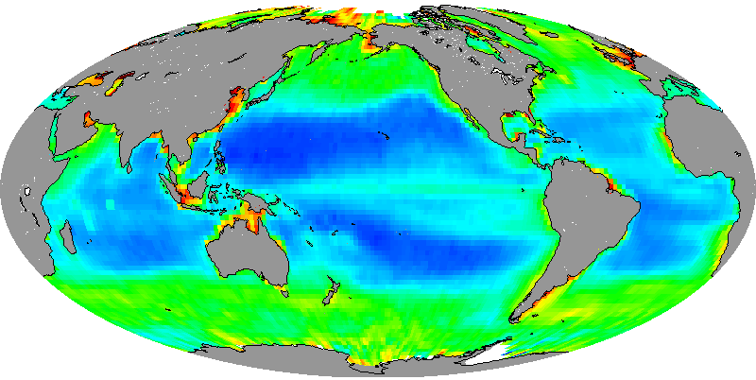

Early results
Independent global data set for quantifying plankton stocks
Space-based lidar measurements of global ocean carbon stocks
CALIOP
MODIS GSM
MODIS QAA
Frequency
Particulate Organic Carbon (mg m⁻³)
Particulate organic carbon (mg m⁻³)
Behrenfeld et al. 2013 Geophys. Res. Lett. 40, 4355-4360
Notes:
used deplolarization ratio (vertically integrated to polarization ratio) estimated what the contribution was fromsurface reflection, then used cloud sat or wind data to remove surface problem
surface flash and calibration of data (goes through the atmosphere)
-depolariation ratio is very well calibrated
- LOOK AT SUPPLEMENT OF MY 2013 PAPER TO UNDERSTAND THIS
<number>

Slide 18
Early results
Global data set to validate ocean color
Bisson et al. (2021) Geophysical Research Letters, 48, e2020GL090909.
Notes:
The basic idea of the sensitivity analysis is to hold the default GIOP configuration constant and allow one change to its parameterization. We chose parameterization changes for each of the spectral shape functions in GIOP (e.g., b_{bp} (V1), a_{cdm} (V2), a_{ph} (V3)) and we also ran GIOP without Raman-corrected R_{rs} (V4). We found that none of the choices in this GIOP sensitivity analysis produce a similar MPE to what is observed with CALIOP. However, spectral shape function choices do have an effect on the performance of MODIS b_{bp}. The GSM b_{bp} power law exponent of -1 (with all other GIOP mechanics held constant) decreases the bias of MODIS b_{bp} beyond any of the other adjustments, although it does not significantly improve the MPE. Changing the a_{cdm} spectral shape function to that of the Quasi-Analytical-Algorithm (QAA, Lee et al., 2002) does not substantially change MODIS performance compared to the optimum, default configuration. Changing the a_{ph} spectral shape function from Bricaud et al. (1998) to Ciotti and Bricaud (2006) increases the bias by ~10% and results in a nearly 20% increase in MPE. Accounting for Raman scattering in this study did not improve the performance metrics of MODIS b_{bp}.
<number>

Slide 19
Early results
Eastern Equatorial Pacific example
January
MODIS
CALIOP
MODIS:CALIOP ratio
Bisson et al. (2021) Applied optics, 60(23), pp.6978-6988.
Notes:
<number>

Slide 20
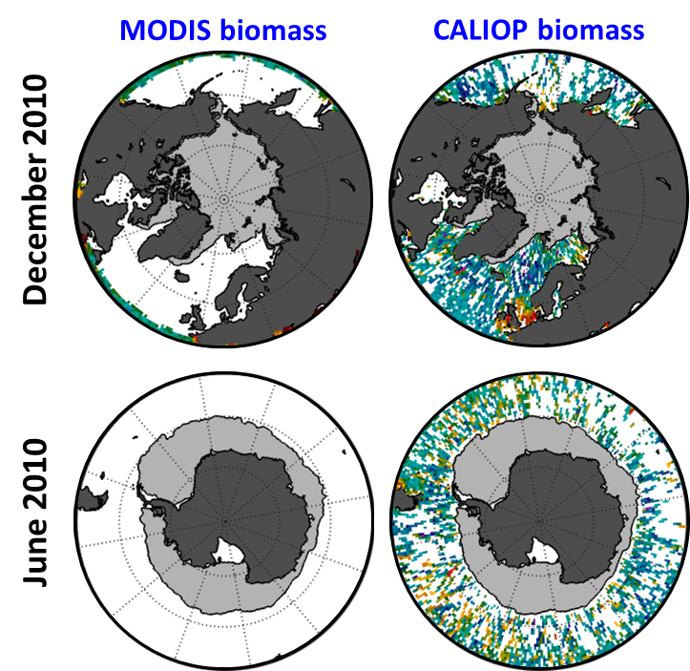

Early results
Day & night sampling
Behrenfeld et al. 2016 Nature Geoscience 19, 118-122

Slide 21
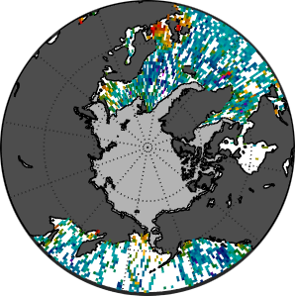
Early results
North Polar Zone
Satellite Lidar
0.01
biomass rate
of change (d⁻¹)
0
Polar Zone
CALIOP biomass
-0.01
Jan
July
Jan
Month
10
20
40
80
100
1
Phytoplankton Biomass (mg C m⁻³)
division
rate (d⁻¹)
0.5
0
Jan
July
Jan
Month
Behrenfeld et al. 2016 Nature Geoscience 19, 118-122

Slide 22
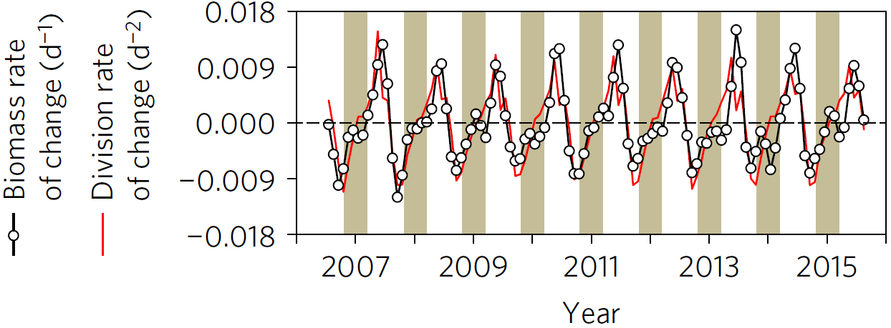
Early results
North Polar Zone
Satellite Lidar
0.01
biomass rate
of change (d⁻¹)
0
Now consider the derivative of this annual cycle…
-0.01
maximum increase rate
initial rise
maximum
termination
decrease rate
1
division
rate (d⁻¹)
0.5
Phytoplankton annual biomass cycles are driven by accelerations and decelerations in division rates because division and loss rates are always tightly coupled but with a short temporal lag in grazing pressure
0
Jan
July
Jan
Month
Behrenfeld et al. 2016 Nature Geoscience 19, 118-122

Slide 23
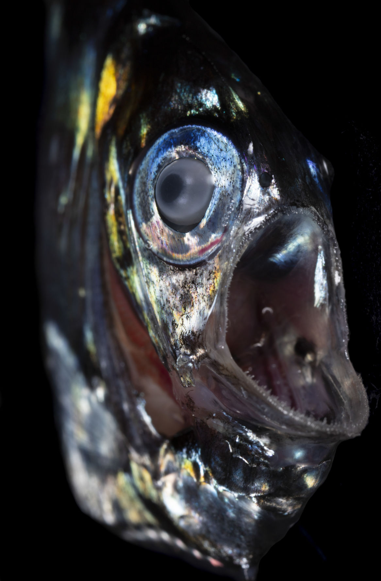
‘DVM’
Diel Vertical Migration

Slide 24
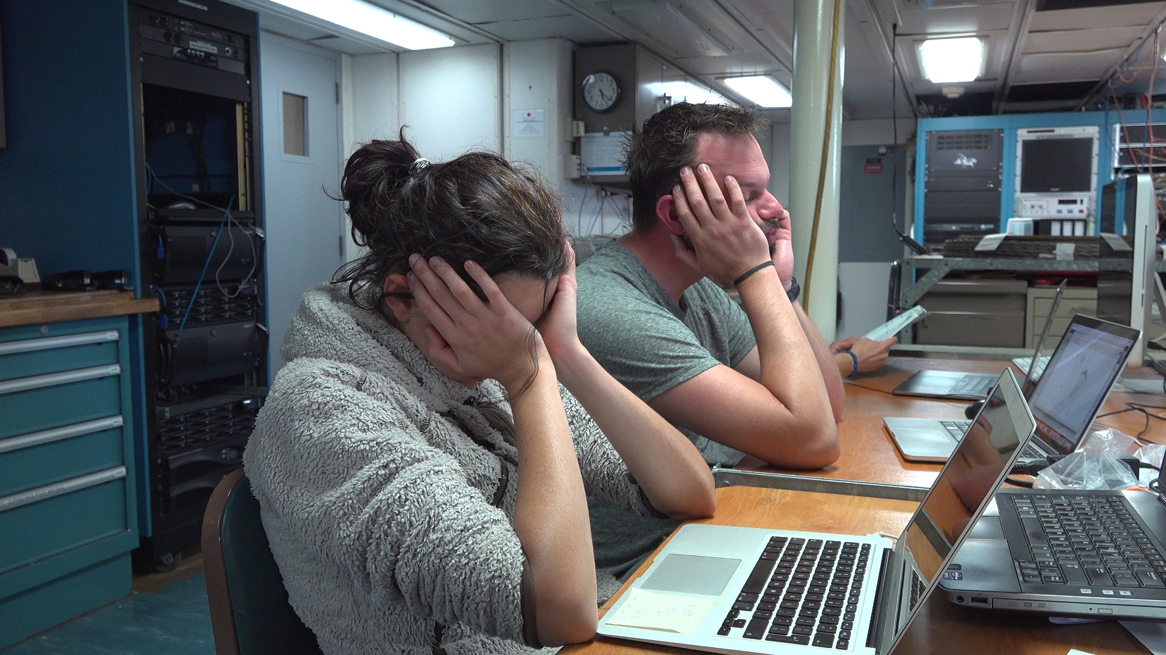

Slide 25
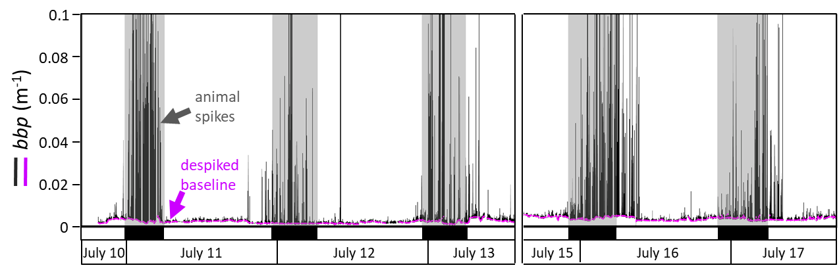
DVM
Burt W. J. & Tortell, P. D. 2018. Geophys, Res. Lett. 45. doi.org/10.1029/2018GL079992

Slide 26
DVM
Idea: The night-day difference between CALIOP bbp data for a given location should include a signal (night increase) from DVM animals
(recall Jim Churnside’s lidar measurements of zooplankton and fish)

Slide 27
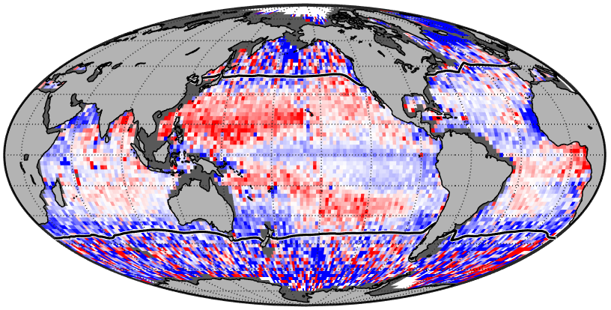
DVM
2° × 2° bin means for the 2008–2017 CALIOP record
CALIOP night-day differences
Why are there negatives?
-8
-6
-4
-2
0
2
4
6
8
∆bbp (%)
Two components: Phytoplankton & DVM
Behrenfeld et al. 2019 Nature 576, 257–261

Slide 28
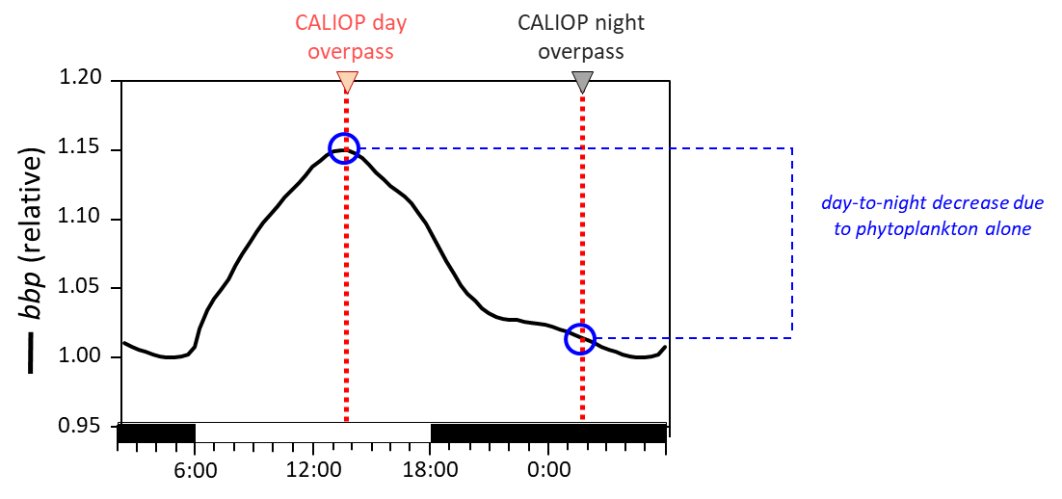
DVM
DVM signal
Main Point: In the absence of DVM animals the night-day difference in backscatter is expected to be negative due to the phytoplankton diel cycle. The nighttime appearance of DVM animals increases backscatter above this baseline such that the night-day difference becomes less negative or even positive
Behrenfeld et al. 2019 Nature 576, 257–261

Slide 29
DVM
Are the lidar DVM signals reasonable?
-8
-6
-4
-2
0
2
4
6
8
∆bbp (%)
Behrenfeld et al. 2019 Nature 576, 257–261

Slide 30
DVM
HOT
BATS
Net-based field measurements of DVM biomass (g m⁻²)
Lidar
∆bbp (%)
J
F
M
A
M
J
J
A
S
O
N
D
J
F
M
A
M
J
J
A
S
O
N
D
Month
Month
… what other data can we compare to?
Behrenfeld et al. 2019 Nature 576, 257–261

Slide 31
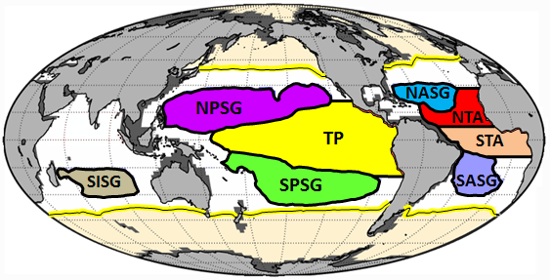
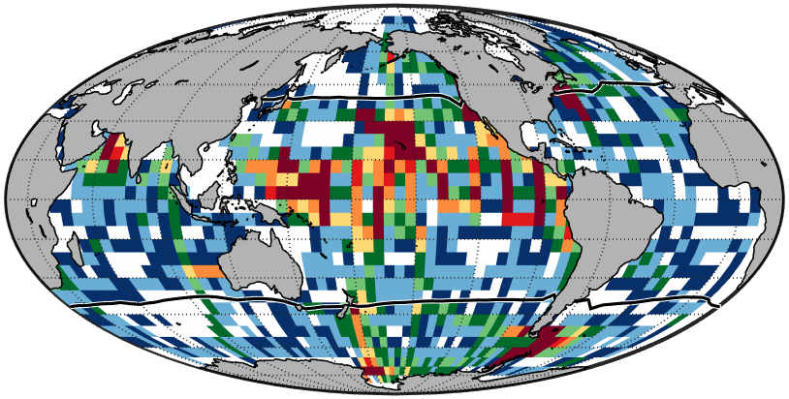
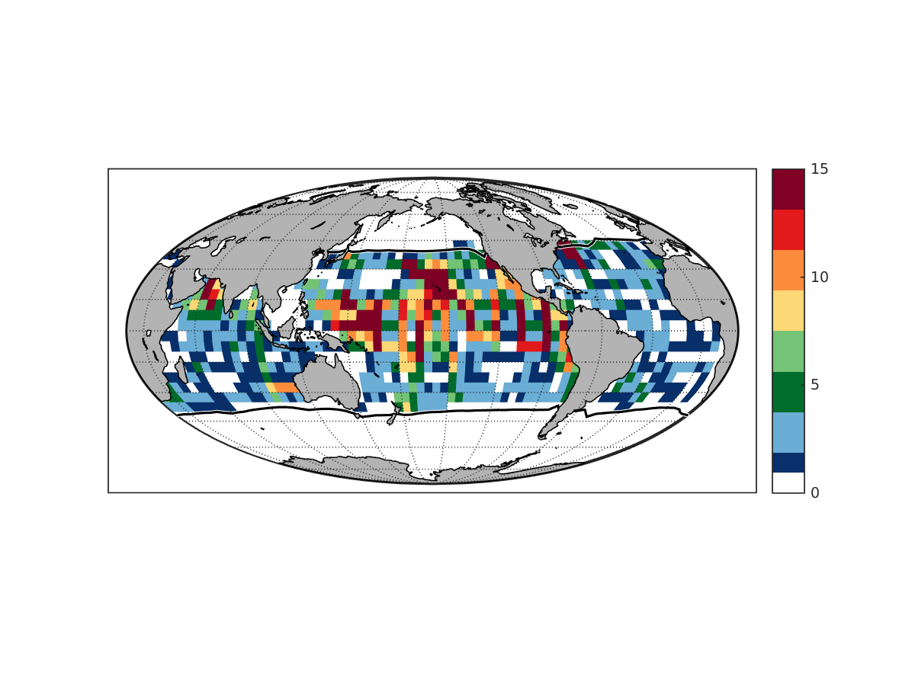
DVM
≥ 14
12 or 13
10 or 11
8 or 9
number of days
Number of days
(2)
6 or 7
(8)
South Pacific Gyre (SPG)
4 or 5
North Pacific Gyre (NPG)
(6)
Central Pacific (CP)
2 or 3
(1)
1
South Central Atlantic (SCA)
∆B_{ADCP} (%)
(2)
(2)
North Atlantic Gyre (NAG)
Global coverage of field ADCP data. Number of days
within 5° × 5° bins for which paired day–night ADCP data are available between 1985–2017 (total # days possible is 11,680). White bins = no data. Yellow/black line = mean SST of 15 °C. White lines = boundaries of PSO regions.
North Central Atlantic (NCA)
(1)
South Indian Gyre (SIG)
(1)
South Atlantic Gyre (SAG)
∆bbp (%)
Behrenfeld et al. 2019 Nature 576, 257–261
(numbers in parentheses indicate median number of observations in each 5ox5o bin for entire 1985-2017 record)

Slide 32
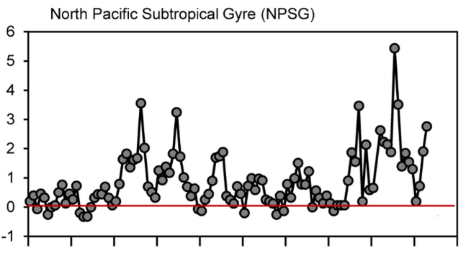
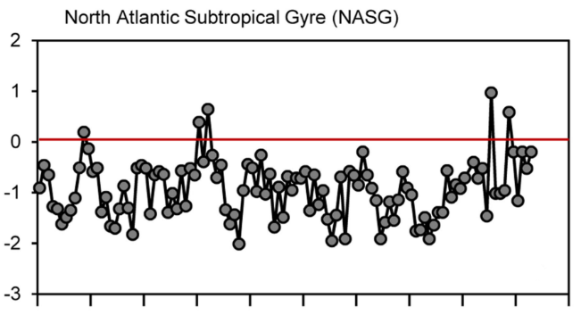
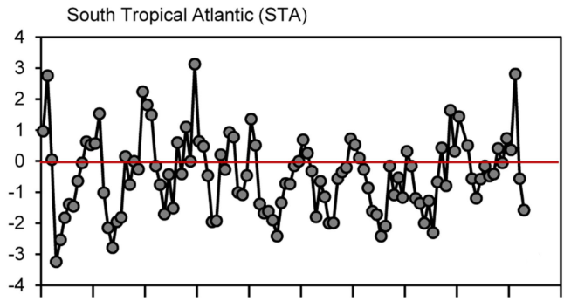
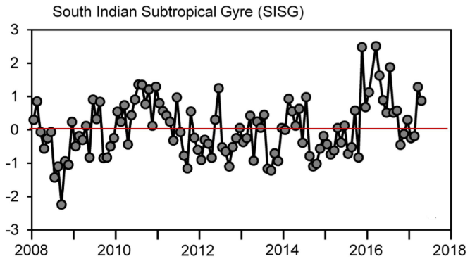
DVM
Emergent Patterns
While the relative DVM signal is inversely proportional to primary production, the absolute DVM signal is positively correlated with primary production. This makes some sense in terms of avoiding visual predators and availability of food.
Temporal trends in DVM anomalies differ from region to region: some are decreasing (e.g., NPG, SPG, SAG, SISG) while others are increasing (TP, NTA, STA, NAG). In most cases, these changes are positively correlated with anomalies in primary production, but sometimes they are (curiously) inversely proportional (e.g., NTA & STA).
Year
In some regions, the DVM contribution to night-day differences in bbp is consistently much larger than the phytoplankton contribution, while in other regions it is consistently smaller than or similar to the phytoplankton signal.
In some regions, the DVM signal exhibits a repeated seasonal cycle, in others seasonality appears and then disappears, while in other oscillations appear to occur on longer time scales.

Slide 33
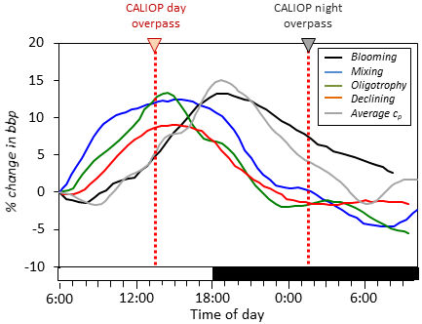
DVM
Challenges
Kheireddine, M., Antoine, D. Diel variability of the beam attenuation and backscattering coefficients in the northwestern Mediterranean Sea (BOUSSOLE site). J. Geophys. Res. Oceans, 119, 5465–5482 (2014).
Freitas, F.H., Dugenne, M., Ribalet, F., Hynes, A., Barone, B., Karl, D.M. and White, A.E., 2020. Diel variability of bulk optical properties associated with the growth and division of small phytoplankton in the North Pacific Subtropical Gyre. Applied Optics, 59(22), pp.6702-6716.
What other factors do we need to consider (e.g., community composition, synchronization of cell cycles, nutrient vs light limitation of growth)?

Slide 34
DVM
Challenges
Bin-to-bin variability at high latitudes is large.
  Match ups are not real match ups
  Unsynchronized phytoplankton division
  Challenging observing conditions (ask me later)
  Spatial variability
-8
-6
-4
-2
0
2
4
6
8
∆bbp (%)

Slide 35
DVM
Challenges
Composition of migrating community and backscattering efficiencies
Vertical distribution of migrators
Concentration of ‘background’ non-algal particles
‘Direct vs indirect’ effect of DVM on night bbp
I like to think of challenges as opportunities for future research. While there are issues yet to be resolved, it is still very exciting to think that there is a signal detectable from space that is linked to ecosystems of the deep ocean.

Slide 36

Thinking ahead

Slide 37
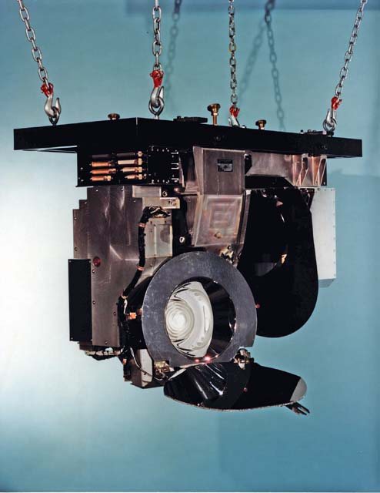
CZCS
CALIOP
CALIOP fortuitously circumvented what is the ‘grave yard’ of many good remote sensing ideas … ‘proof-of-concept’ in space
… the question now is, “what could we do if we actually built a satellite lidar optimized for oceanographic research?”
Notes:
CALIOP is an atmospheric sensor and NOT a blueprint for future ocean lidars
<number>

Slide 38
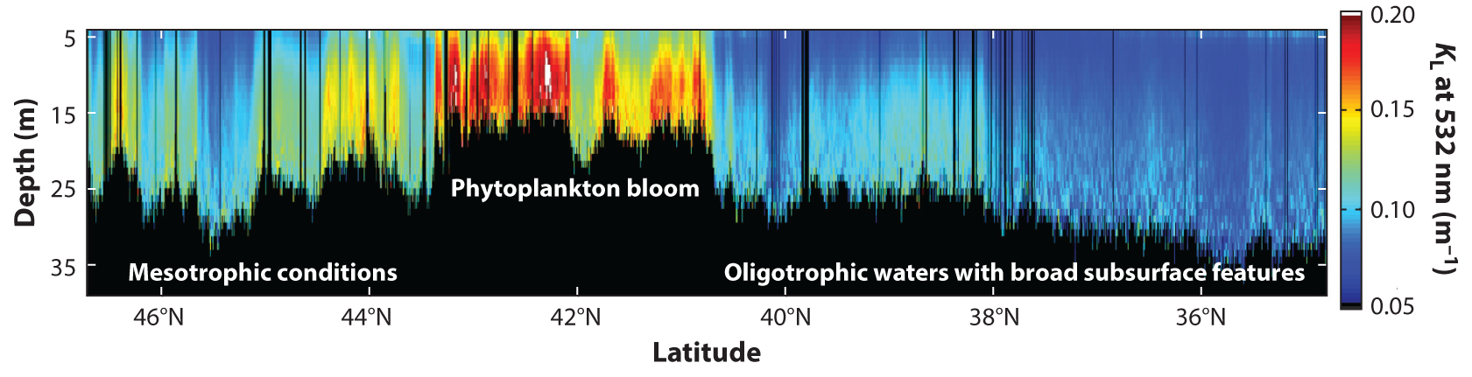
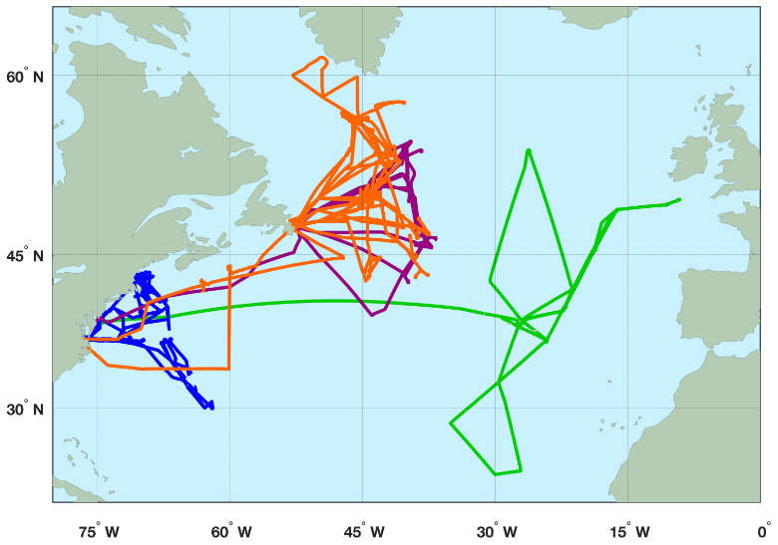
High Spectral Resolution Lidar (HSRL)
b_{bp} (m⁻¹, HSRL)
r = 0.94
b_{bp} (m⁻¹, in situ)
(top) Hostetler et al. (2018) Annu. Rev. Mar. Sci. 10:121–47; (bottom right) Schulien et al. (2017) Optics Express 25:13577-87

Slide 39
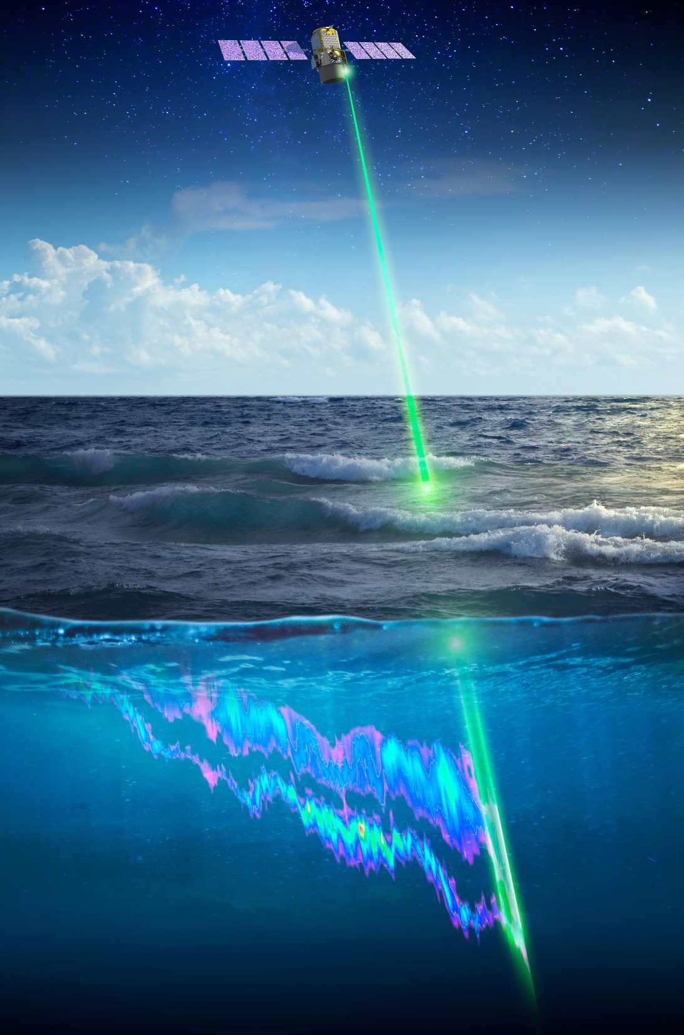
A future lidar mission
…above and beyond CALIOP…
HSRL approach
Meter-scale vertical resolution
(option #1) Laser emissions at 1064, 532, & 355 nm
(option #2) Laser emissions at ~480 nm (Fraunhofer line) – penetration to bottom of photic zone
chlorophyll fluorescence detection bands
Parting thought…
we should think about satellite lidar and ocean color as complementary technologies that, when flown together, provide a potential for new understanding beyond that of each one flown separately.

Slide 40
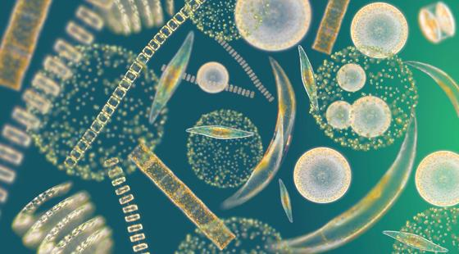
Chris Hostetler
Yongxian Hu
Johnathan Hair
Jennifer Schulien
Emmanuel Boss
David Siegel
Jorge Sarmiento
Giorgio Dall’Olmo
Sharon Rodier
Charles Trepte
Xiaomei Lu
Amy Jo Scarino
Robert O’Malley
Kelsey Bisson
NASA Ocean Biology and Biogeochemistry Program
NASA Earth Science Technology Office
NASA Airborne Instrument Technology Transition Program
Thank you!

Slide 42
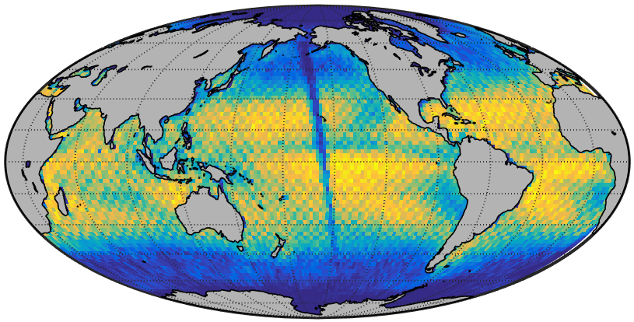
0
20
40
60
80
100
Number of months with paired day and night retrievals

Slide 43
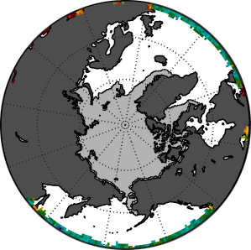
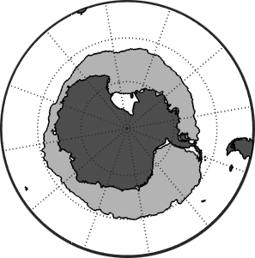
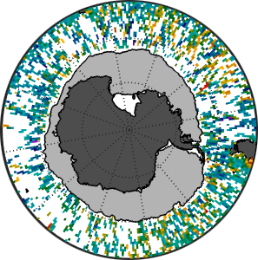
CALIOP Shines on Polar Ecosystems
50
Phytoplankton
biomass (mg C m³)
25
December 2010
comparison zone
0
MODIS
CALIOP
2007
2009
2011
2013
2015
Year
MODIS biomass
CALIOP biomass
50
Phytoplankton
biomass (mg C m³)
25
June 2010
comparison zone
MODIS
CALIOP
0
2007
2009
2011
2013
2015
Year
10
20
40
80
100
Phytoplankton Biomass (mg C m⁻³)
Behrenfeld et al. 2016 Nature Geoscience 19, 118-122

Slide 44
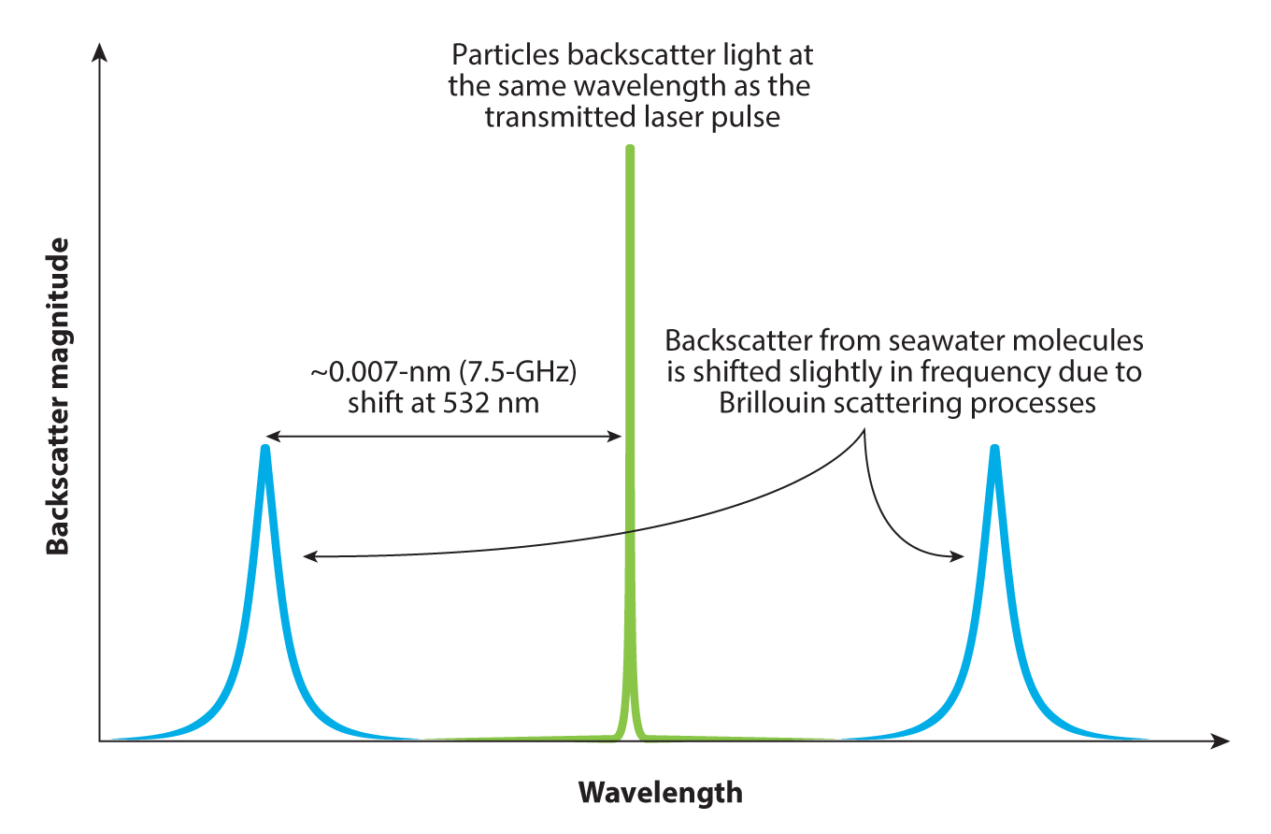
High Spectral Resolution Lidar (HSRL)
Hostetler et al. (2018) Annu. Rev. Mar. Sci. 10:121–47

Slide 45
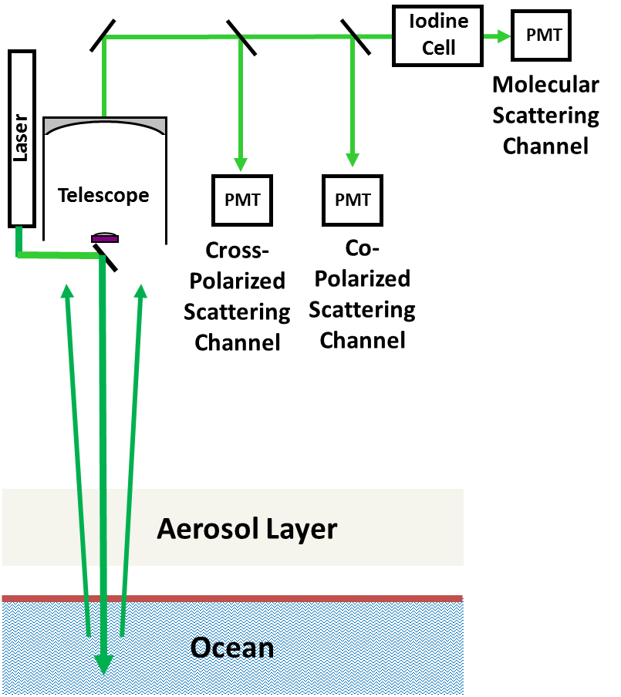
High Spectral Resolution Lidar (HSRL)
Laser tuned to I₂ absorption line
Standard channels = attenuated water and particulate backscatter
Filtered channel = attenuated water backscatter
Water backscatter well known
A ‘well-posed problem’: 2 measurements, 2 unknowns (b_{bp}, k_{d})

Slide 46
355 nm Molecular
Channel
Detec-tor
Detec-tor
355 nm Particulate+Molecular Channel
Interferometer
680 nm Chlorophyll Fluorescence
Channel
532 nm Particulate+Molecular Channel
355 nm Cross-Polarization
Channel
Detec-tor
Detec-tor
Detec-tor
Solar
Background
Filters
Interferometer
Seed
Laser
Solar Background
Filters
Field Stop
Transmitter
Detec-tor
Detec-tor
Detec-tor
Pulsed Laser
1064 nm Cross-Polarization Channel
532 nm Cross-Polarization
Channel
532 nm
Molecular Channel
Telescope
Detec-tor
1064 nm Co-Polarization Channel

Slide 47
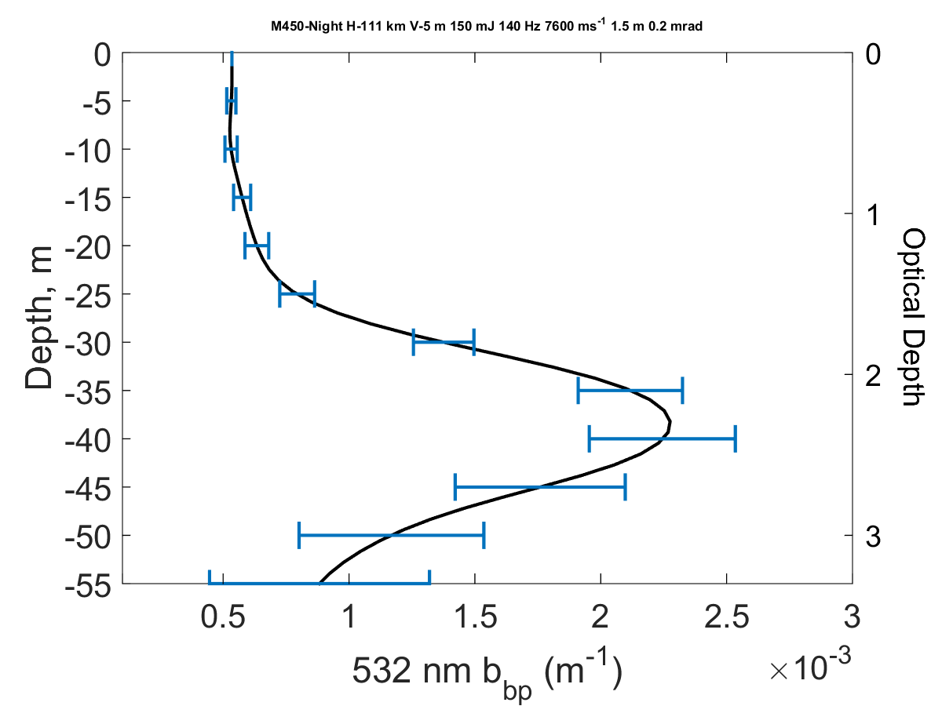
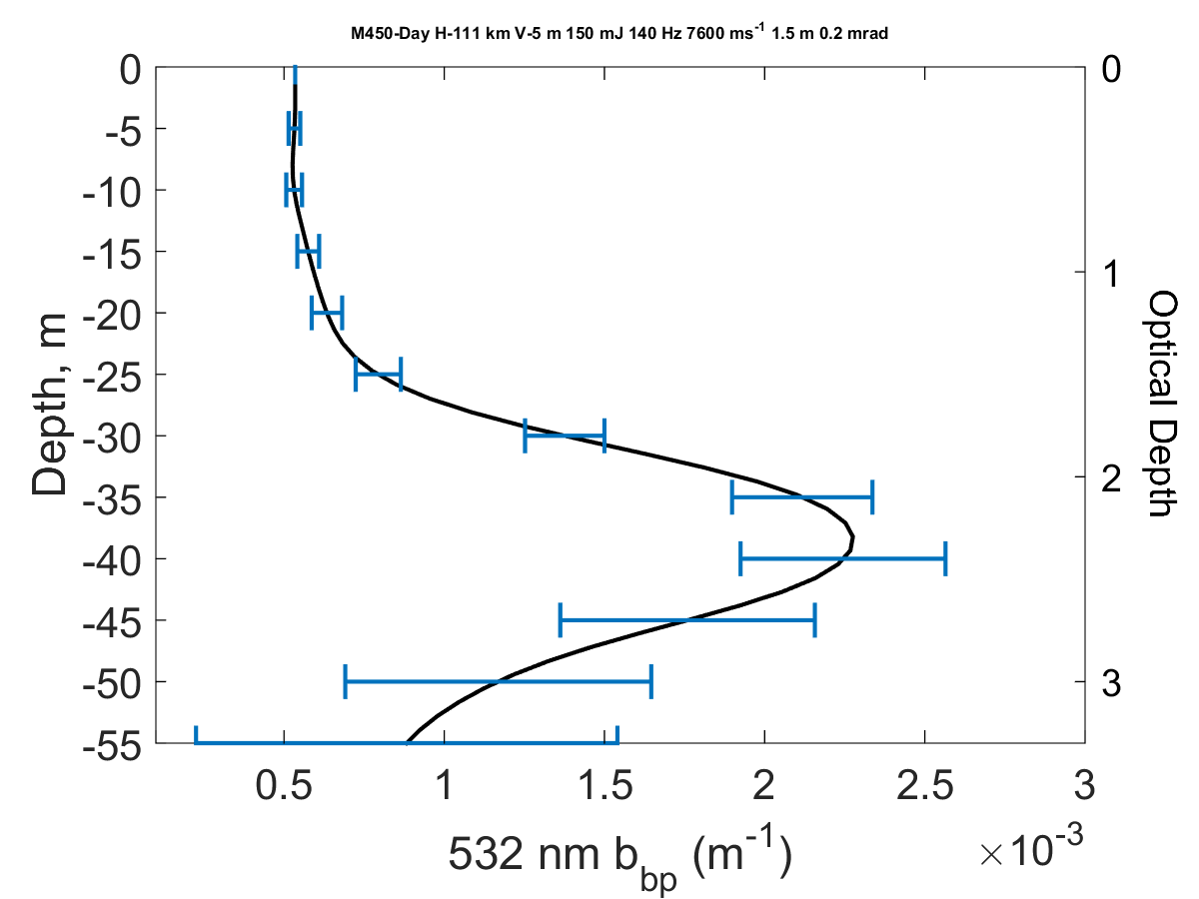
Spaceborne HSRL profiling possible to 3 optical depths
Night
Day
Simulated profiling through 70% of the euphotic zone possible with a realizable system
  150 mJ at 140 Hz at 532 nm
  1.5 m telescope (similar to ADM-Aeolus)
  Altitude 450 km for these simulations
Resolution/precision can be increased via changes in instrument parameters

Slide 48
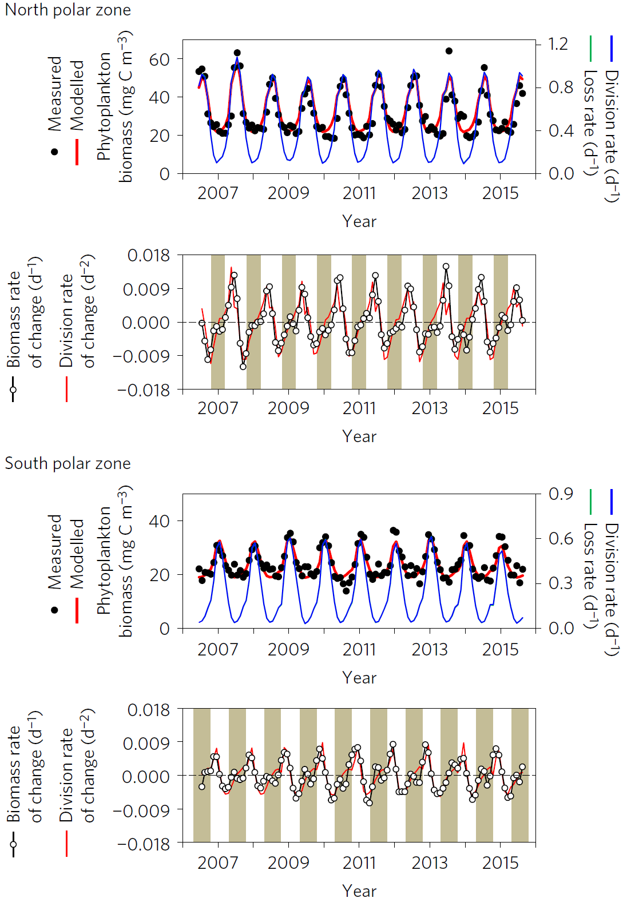

Slide 49
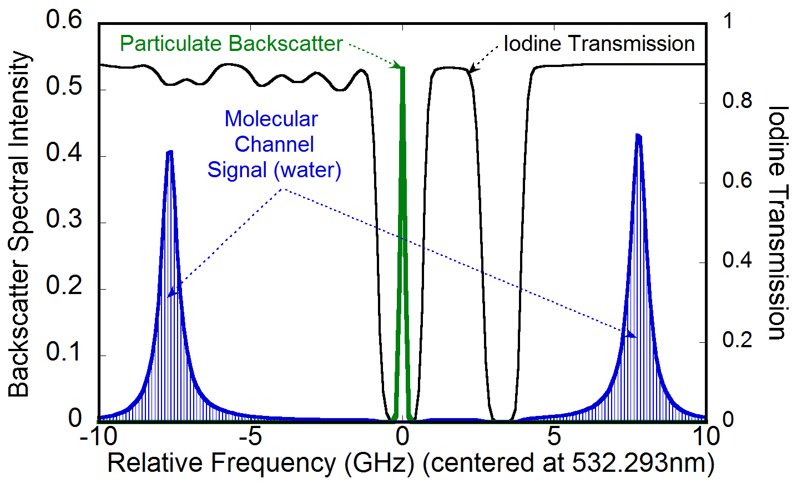
High Spectral Resolution Lidar (HSRL)
Laser tuned to I₂ absorption line (can also use interferometer)
Particulate backscatter blocked from “Molecular Channel”

Slide 50


High Spectral Resolution Lidar (HSRL)
A ‘well-posed problem’: 2 measurements, 2 unknowns (b_{bp}, k_{d})
Notes:
HSRL designs vary from instrument to instrument, but the fundamental approach is the same. We will consider here the simplest of HSRL architectures where there are two detection channels. One of these channels is more sensitive to particulate backscatter from the ocean (the middle peak in Figure 2) and one is more sensitive to molecular backscatter from seawater itself (the right and left peaks in Figure 2). This separation of the backscatter signal is accomplished in the lidar receiver (Figure 1) with a spectral filter (e.g., an interferometer) that has a well characterized frequency response. The two time-resolved signals are combined to form two profiles proportional to backscatter at 180˚. The first of these derived profiles, S_{M}(z), represents photons backscattered by water (β_{M}): where the integral of K_{d} and the square of the atmospheric transmission account for the attenuation that the transmitted and backscattered photons undergo along their optical paths. C_{M} is a channel-specific instrument constant that incorporates factors like laser energy, telescope area, and the efficiency of receiver components. The second profile, S_{P}(z), represents photons backscattered by suspended particles in the ocean (β_{P}) and likewise attenuated by the ocean (K_{d}) and atmosphere: where C_{P} is the instrument constant for the second channel. Because the density of seawater molecules is relatively constant in the near-surface ocean, the value of β_{M} is well known. Thus, the value of K_{d} can be calculated from changes in S_{M}(z) from one depth interval to the next through the water column: Importantly, the influence of K_{d} and atmospheric transmission are the same for S_{P}(z) and S_{M}(z). Consequently, these two terms cancel in the ratio S_{P}(z):S_{M}(z), allowing the attenuation-corrected profile of particulate backscatter at 180˚ to be calculated as: where the only scaling factors required are estimates of β_{M} (well-known) and the C_{M}:C_{P} ratio (which is easily calibrated with high accuracy). β_{P} is then scaled to hemispheric backscatter, b_{bp}, following Boss & Pegau (2001).
In summary, the power of the HSRL technique is that it provides two measurements to solve for two unknowns and requires only relative (i.e., the C_{M}:C_{P} ratio), rather than absolute, calibration. This contrasts critically from the elastic backscatter lidar technique, which provides the combined S_{P}(z)+S_{M}(z) profile only and therefore requires absolute calibration, correction for the atmospheric transmission, and either ancillary data or model assumptions on the relationship between b_{bp} and K_{d} to retrieve either one.
<number>

Slide 51
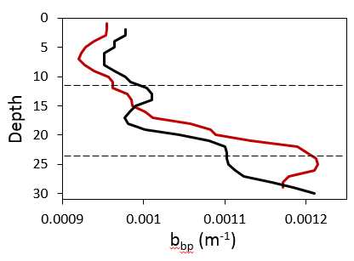
Ocean Retrievals with HSRL
Accurate retrievals of b_{bp} and k_{d} @ 1m resolution to ~3 optical depths
Match-ups have spatial & temporal differences
Improvements in ΣNPP >50% for SABOR (other studies > 100%)
K_{d} (m⁻¹, HSRL)
r = 0.96
K_{d} (m⁻¹, MODIS)
in situ
HSRL
1 optical depth
Depth
b_{bp} (m⁻¹, HSRL)
2 optical depths
r = 0.94
b_{bp} (m⁻¹)
b_{bp} (m⁻¹, in situ)
Data from John Hair (NASA LaRC) & Schulien et al. 2017 Optics Express 25:13577-87
Notes:
Comparison to the semi-analytic (QAA) retrieval by Z. Lee.
Conversion of wavelength only includes the spectral difference in the absorption of water. no other conversions attempted
Number of Flights: 20 over 14 different days
Coincidence: temporally on the same day, lidar data averaged to 4km pixel of satellite.
<number>

Slide 52
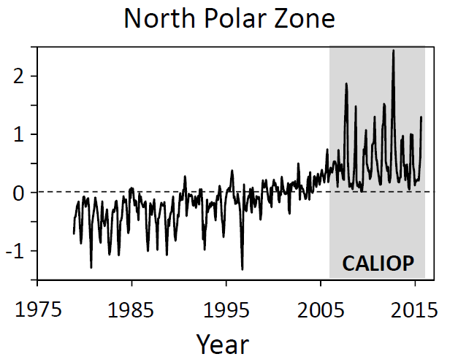

Early results
…now, let’s use the complete annual cycle coverage provided by CALIOP to look at bloom dynamics…
Behrenfeld et al. 2016 Nature Geoscience 19, 118-122
Notes:
6 month anomalies
<number>

Slide 53

DVM
= DVM_{CALIOP} temporal trend significant (p < 0.05) for given 6º x 6º bin
NP
NA
30%
.
20%
= DVM_{CALIOP} significantly (p < 0.05) and positively correlated with NPP_{CbPM}
.
.
.
.
.
.
.
.
.
.
.
.
10%
.
.
.
.
.
.
.
DVM_{CALIOP} trend (% decade⁻¹)
.
.
.
.
.
.
0%
.
.
= DVM_{CALIOP} significantly (p < 0.05) and negatively correlated with NPP_{CbPM}
.
.
.
.
.
.
.
.
.
.
-10%
.
.
.
.
.
.
.
-20%
no outline = DVM_{CALIOP} and NPP_{CbPM} not significantly (p > 0.05) correlated
SO
-30%
Behrenfeld et al. 2019 Nature 576, 257–261

